Slide 1

Superintendent’s Report
Board of Education Meeting
10/4/22

Slide 2
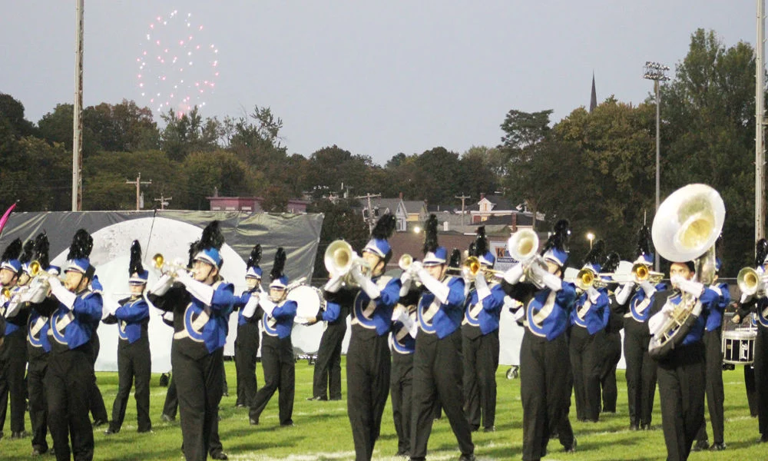

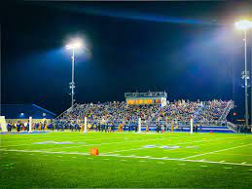
Congratulations…
Congrats – Marching Buccaneers
We held our 43rd Pageant of Champions – Oct 1
  9 school districts participated in this year’s pageant
  Job Well Done!

Slide 3
Rachel’s Challenge OHS Chain Reaction
OHS had nearly 200 students participate in this year’s Rachel’s Challenge – Chain Reaction event
The event was held on September 27th & September 28th
The Chain Reaction activity day is a transformational day of fun, leadership, and empowerment that encourages participants to view others as valuable
The goal of Chain Reaction is to help stop bullying, violence, and alienation
Through a variety of games, trust-building activities, and presentations, participants learn to view others and themselves in a positive manner
Rachel’s Challenge is a nonprofit organization dedicated to equipping and empowering students and adults to sustain a positive culture in their schools and communities by starting a chain reaction of kindness and compassion
This program was developed out of recognition of the life and writings of Rachel Scott, -- the first person killed in the Columbine High School shootings on April 20, 1999
Since its inception, over 23 million people have heard Rachel’s story in live settings worldwide

Slide 4




Read to Them
Read to Them promotes personal and academic success in students by providing the reading-based structure to forge lasting partnerships between families, schools, and their communities.
OCSD received a grant from RTT to support “One School, One Book”

Slide 5
Study Information
Tonight:
  Labor relations information
  Real-estate information
  Current enrollment and average class sizes
  ThoughtExchange
Future meeting(s):
  Class size information
  Redistricting plan
  Community Focus Group outcomes
  Building Condition Survey information

Slide 6
Labor Relations Data – 2022- 23 Retirement Projections
OCTA | CSEA | AAP & Non- Affiliated
20 Teachers with 30 years of service credit and age 55 10 Elementary 10 Secondary Note: There are others who are age eligible but may not meet the minimum (30) years of service credit to get maximum retirement benefit | 11 CSEA members with 30 years of service credit and age 55 Note: There are others who are age eligible but may not meet the minimum (30) years of service credit to get maximum retirement benefit | 3 AAP and/or COASA members with 30 years of service credit and age 55 2 AAP 1 Non – Affiliated Note: There are others who are age eligible but may not meet the minimum (30) years of service credit to get maximum retirement benefit

Slide 7
Real-estate Information
The district recently completed a review of recent local real-estate
Support was provided by City of Oswego representatives

Slide 8
Name | Information | Costs
Property: Litatro Address: 189 W 1st St, Oswego NY 13126 | Litatro (“Luck Is the Ability to Recognize Opportunity”) is locally owned / operated and features premiere retail, upscale commercial spaces, 20 luxury apartments, underground parking, select restaurants on the first floor, World-Class Eats on the rooftop deck complete with stunning views of the city and river. | 1 Bedroom- $1,300-$1,750 2 Bedroom -$1,900-$2,750 Note: No children are currently living in this facility and attending Oswego CSD

Slide 9
Name | Information | Costs
Property: Riverwalk Address: 155 W 1st St Oswego, NY 13126 | Riverwalk Apartments and Restaurants are locally owned and veteran owned Featured as a four-story, mixed-use hub, Riverwalk showcases 32 luxury, waterfront apartments and underground parking, with an oven-fired pizza restaurant and handmade bagel shop on the first floor | 1 Bedroom- $1,480 - $1,980 2 Bedroom -$1,935 - $2,340 Note: No children are currently living in this facility and attending Oswego CSD

Slide 10
Name | Information | Costs
Property: Lock 7 Apartments Address: 220 East First St. Oswego, NY 13126 | DePaul Properties, Inc. creates and operates attractive, affordable housing solutions in urban, suburban and rural settings within environments that promote respectful community relationships All units are subject to income eligibility and occupancy requirements There are a total of 80 units centrally located in this residential setting. There are 40 low income – tax credit program apartments available (34 one-bedroom and 6 two-bedroom apartments) On-site services are available for the other 40 units (34 one bedroom and 6 two bedroom apartments), with housing specialists that teach skills and assist tenants in linking to community services. 20 of these units are ADA accessibility and 4 of these units are hearing and vision accessible (HVA) 40 of the applicants must meet the following conditions: Must meet health requirements which require supportive services Must be homeless or facing homelessness and/or Senior citizen – facing homelessness and require supportive services | Rent is calculated at the average monthly household income Based on 1-4 persons: 60% AMI - $563 - $750 30% AMI - $ 400- $500 All applicants must meet the eligibility requirements of the Low-Income Housing Tax Credit Program. Income and occupancy requirements apply. Note: There is a possibility that we may receive up to 10 students from this property (5 children just moved in but were already living in district).

Slide 11
Name | Information | Costs
Property: East Lake Commons Address: 18 Cayuga St Oswego, NY 13126 | East Lake Commons is a five-story building for income qualified families and individuals with 70 residential units. Apartments are subject to a lottery system. Availability is income based, where gross income must be equal to or less then 50%, 60% or 80% of the area median income | 46 -1 Bedroom- $630 - $975 24 - 2 Bedroom -$740 - $1,167 Note: There is a possibility that we may receive up to 10 students from this property

Slide 12
Name | Information | Costs
Property: Harbor View Square Address: 68 W 1st St Oswego, NY 13126 | Harbor View Square is a $29.2 million mixed-income, mixed-use revitalization project on Oswego’s waterfront The transformational development includes a 5-story structure containing 57 rental units of modern, high quality urban living space There is also 3, 2-story structures with 18 townhomes There is 10,000 square feet of retail/commercial space in the Harbor West neighborhood | Total 75 units: 57 Rentals 18 Town Homes Rental units are from $655 and up Town Home cost not available Note: We currently have 31 children who attend our schools who live in Harbor View Square

Slide 13
Name | Information | Costs
Property: Champlain Commons Address: 6 Samuel Way Oswego, NY 13126 | Champlain Commons has been open for 3 years. It is located in the Town of Scriba Overseen by OCO The community is operated under the Low-Income Housing Tax Credit Program (LIHTC). This program is designated to facilitate the housing needs of moderate to low income individuals and families. | 30% Income: 14 - 1 bedroom $555 5 - 2 bedroom $653 3 - 3 bedroom $743 50% Income: 14 - 1 bedroom $555 5 - 2 bedroom $653 60% Income: 6 - 2 bedroom $689 12 - 3 bedroom $851 Note: Utilities are included in rent and the district currently has 28 students attending who live in this property.

Slide 14
Summary of Information - student projections
Name | Projections
Litatro | 0
Riverwalk | 0
Lock 7 Apartments | 10 estimate (Note:5 students already moved in who are already living in the district)
East Lake Commons | 10 estimate
Harbor View Square | 31 (already enrolled at OCSD)
Champlain Commons | 28 (already enrolled at OCSD)
Total Students: | 79 (64 already enrolled at OCSD)

Slide 15
Student Enrollment Data – Information
(Part 1)

Slide 16

Purpose of the Data Reports
To provide useful evidence to advance the
Board of Education’s decision-making process.

Slide 17
Facilities Efficiency Studies Review (12 Studies) Studies)
Date | Study Conducted By | Findings
June 2012 | Oswego County BOCES (CITI)-Cathy Chamberlain | Analyzed enrollment trends and 5 year projections Examined the idea of grade reconfigurations of K-5, 6-8, and 9-12. Findings showed K-12 enrollment from 2001 to 2012 decreasing by 1,058 students (5,010 to 3,953).
January 2012 | William Crist, Superintendent of Schools | Analyzed full redistricting to balance building enrollment by re-aligning the building’s boundaries
December 2010 | Office of Professional Research and Development at Syracuse University | Reconfiguration and Relocation Planning Study-Meta analysis of former studies The report was conducted to help the BOE make the decision on 1) possible reconfiguration of the school district’s elementary schools and 2) final disposition of the Education Center at 120 East First Street in Oswego
January 2010 | OCSD Reconfiguration Committee | Reutilizing the Leighton Elementary School as a possible 9th grade annex Elementary grade reconfiguration: centrally locating UPK, K-5, 6-8, and 9-12 Consider the closure of the Education Center at 120 East First Street in Oswego
August 2009 | OCSD Reconfiguration Committee | Reutilizing the Leighton Elementary School as a possible 9th grade annex or UPK-3 House all UPK classes at Leighton Elementary School CER & MIN would function as grades 3-6 and KPS & FPS as K-2 Sell the Education Center and move it all Education Center Offices and Services to Leighton Elementary School Utilize a portion of Leighton for high school PE & Athletics and/or alternative high school programs and art

Slide 18
Facilities Efficiency Studies Review-Continue
Date | Study Conducted By | Findings
March 2007 | OCSD Reconfiguration Committee | Focus on balanced class sizes across elementary buildings Grade reconfiguration Focus on transient student population Since there is clearly declining enrollment, it would be fiscally responsible to reduce the number of elementary schools (model 1 suggested closing the oldest schools KPS & FPS)
November 2007 | OCSD Reconfiguration Committee & Cathy Chamberlain | Reconfiguration of grade levels: UPK-4, 5-8, 9-12 Close Minetto Elementary School
April 2006 | SUNY Oswego Issue Analysis-Grade Configuration Report | Reconfiguration of grade level study suggested that the District should strive to minimize the number of transitions This study contained a parent survey that asked them to rank factors affecting students such as class size, teacher choice, tax levy, travel to school, and neighborhood schools
November 2006 | Oswego County BOCES-Cathy Chamberlain | Decline in enrollment from 2001-2006 (5,010 to 4,605) Decline in enrollment projects from 2006-2011 (4,605 to 3,955) This study included an open-ended survey for teachers and the community
May 2005 | Christa Construction, LLC. | Education Center relocation study-location, space (square foot), services, conference rooms, and operation cost were examined Four scenarios were proposed: 1) relocate to FLS, 2) construct new facility, 3) relocate and lease the space and 4) stay in existing facility

Slide 19
Facilities Efficiency Studies Review-Continue
Date | Study Conducted By | Findings
November 2002 | OCSD Reconfiguration Committee | The study explored elementary grade level configuration Findings suggest that configuration does not breed success, instruction is key Review of the current research suggest that there is no elementary grade level configuration that is better than others Suggestion that future committees explore grade K-8 configuration
February 1997 | OCSD Redistricting Committee | The redistricting committee explored literature, research, and case studies on trends in grade configurations and class sizes Review of the current research suggest that there is no elementary grade level configuration that is better than others Having fewer students and grade sections can be difficult to justify and renders a school district vulnerable to criticism regarding the ability to provide quality instructional programs and student support services.

Slide 20
Facilities Efficiency Studies Summary
Note: When facilities efficiency studies began the student enrollment was at 5,370 in 1996-97. Student enrollment has declined by 1856 students to 3,514 in September 2022-23.
Themes of Studies:
              Specific enrollment trends (decline)…4
    The following studies were generated based on declines in enrollment:
                Grade reconfiguration…9
              Building boundary adjustments…1
              Reutilizing Leighton/closing an elementary building…4
                Education Center Closure…4
              Surveys to community…2 (what parents and teachers value in education)

Slide 21
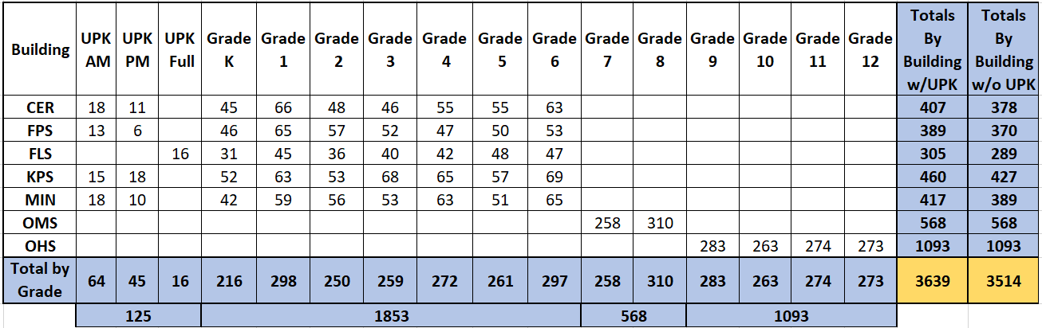
September 2022 Enrollment
Homeschooled Students….200
Non-Public School Students…157
Out of District Students…..60
Pre-School Students (CPSE)…53

Slide 22
September 2022 Elementary Class Sections & Class Size
Building | K | 1 | 2 | 3 | 4 | 5 | 6 | Total
CER | 3 Sections 15, 15, 15 | 3 Section 22, 22, 22 | 3 Sections 16, 16, 16 | 3 Sections 15, 17,14 | 3 Sections 18, 19, 18 | 3 Sections 18, 17, 20 | 3 Sections 21, 21, 18 | Sections=21 Median=17
FPS | 3 Sections 16, 17, 13 | 4 Sections 16, 17, 16, 16 | 3 Sections 20, 20, 17 | 3 Sections 18, 18, 16 | 3 Sections 18, 14, 15 | 3 Sections 16, 17, 17 | 3 Sections 18, 18, 17 | Sections=22 Median=17
FLS | 2 Sections 15,16 | 2 Sections 23, 22 | 2 Sections 17, 19 | 2 Sections 20, 20 | 2 Sections 20, 22 | 2 Sections 24, 24 | 2 Sections 23, 24 | Sections=14 Median=21
KPS | 3 Sections 19, 17, 16 | 3 Sections 22, 21, 20 | 3 Sections 17, 18, 18 | 3 Sections 22, 23, 23 | 3 Sections 19, 23, 23 | 3 Sections 20, 19, 18 | 3 Sections 23, 22, 24 | Sections=21 Median=20
MIN | 3 Sections 14, 14, 14 | 4 Sections 16, 14, 16, 13 | 3 Sections 17, 20, 20 | 3 Sections 18, 19, 16 | 3 Sections 21, 21, 21 | 3 Sections 17, 17, 17 | 3 Sections 21, 22, 22 | Sections=22 Median=17
Total Sections & Median Class Size | Sections=14 Median=15 | Sections=16 Median=18 | Sections=14 Median=18 | Sections=14 Median=19 | Sections=14 Median=20 | Sections=14 Median=18 | Sections=14 Median=21 | Total Sections & Median Class Size
Median Sections: Grades K-2=14, Grades 3-6=14
Median Class Size: Grades K-2=18, Grades 3-6=20

Slide 23
September 2022 Student Services
Type of Service | Student Count
Title 1 Students (CER, FPS, FLS, OMS, OHS) | 2,698 (77%)
Special Education K-12 | 638 (18%)
Special Education CPSE (Pre-School) | 53
Students with 504 Plans | 143 (4% +)
Out of District Students (BOCES, etc.) | 22
MV/Homeless Students | 139 (4%)
English Language Learners (ELL) | 35 (1%)

Slide 24
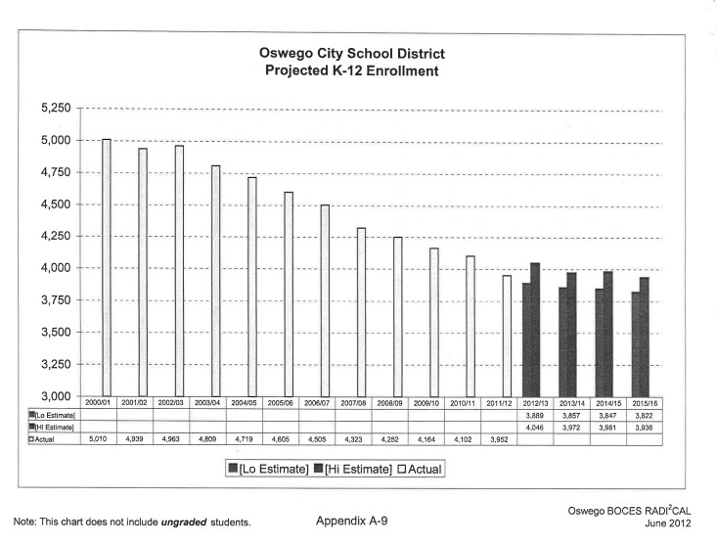
2012 Enrollment Projection from CITI BOCES Study
During the years of 2000-01 to 2011-12, the average yearly enrollment decline was 108 students.

Slide 26
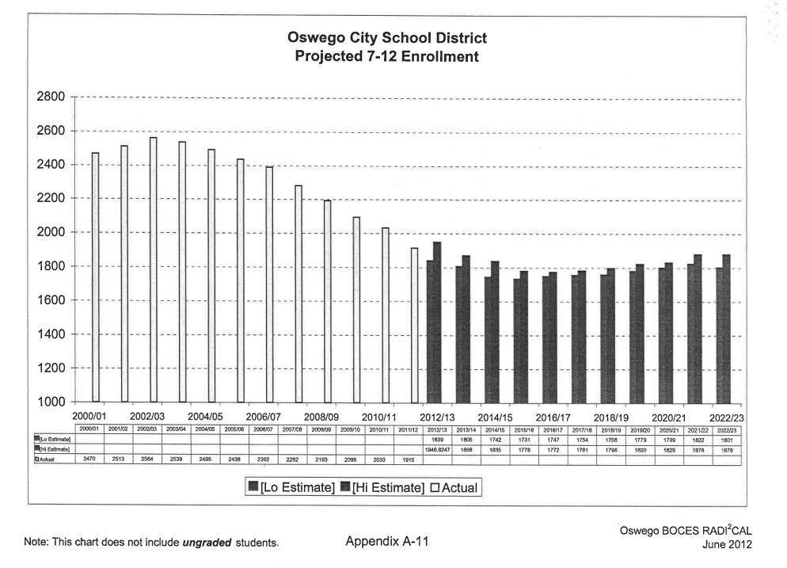
2012 Enrollment Projection from CITI BOCES Study
September 2022 grades 7-12 current student enrollment is 1661

Slide 27

ThoughtExchange Data

Slide 28

Exchange Summary
Oswego City School District
October 4, 2022
We asked participants the following question:
Please provide your feedback on any or all of the 5 recommendations that were outlined in Part 4-of the districts’ Comprehensive Efficiency Study, including the potential of repurposing Frederick Leighton Elementary School.

Slide 29
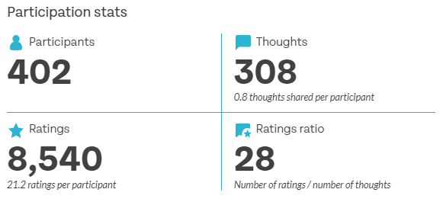
PARTICIPATION
Breakdown of Participation:

Slide 30
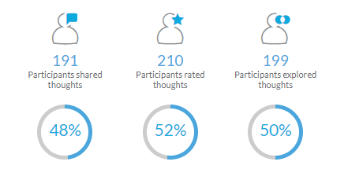
PARTICIPATION
Breakdown of Participation

Slide 31
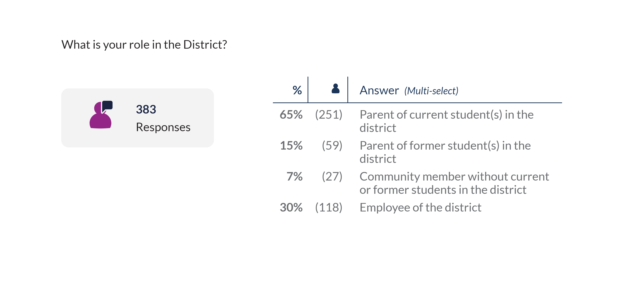
PARTICIPATION
Breakdown of Participation

Slide 32
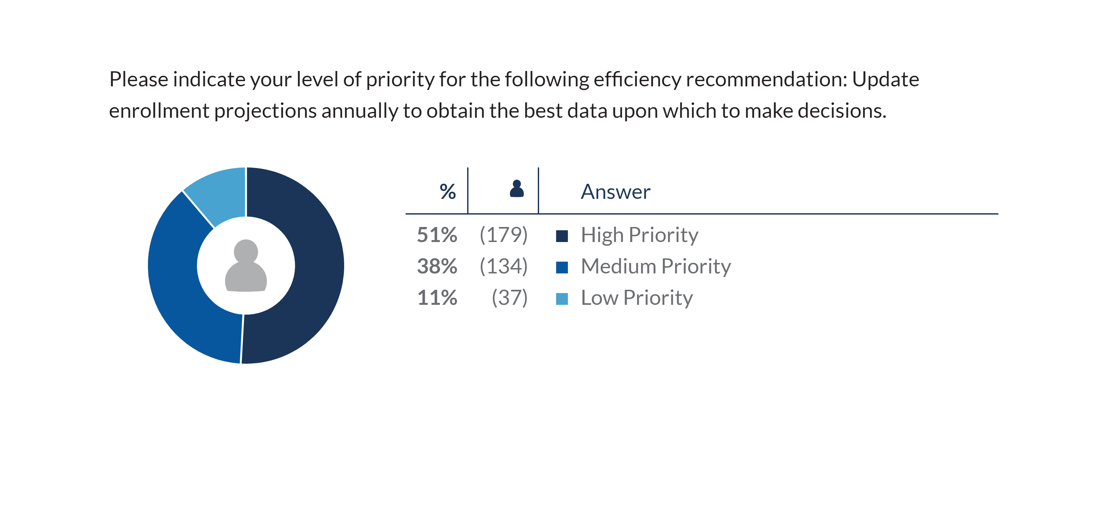
SURVEY RESPONSES: Enrollment Projections

Slide 33
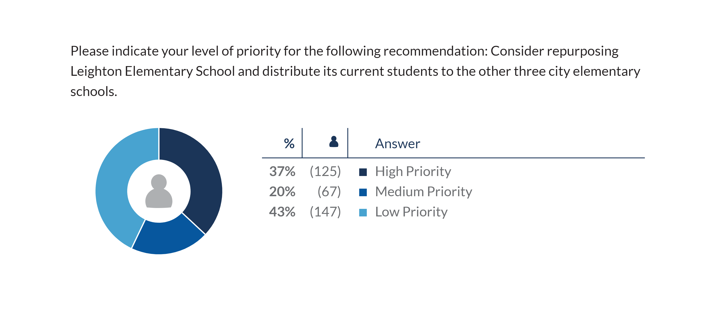
SURVEY RESPONSES: Repurposing Leighton

Slide 34
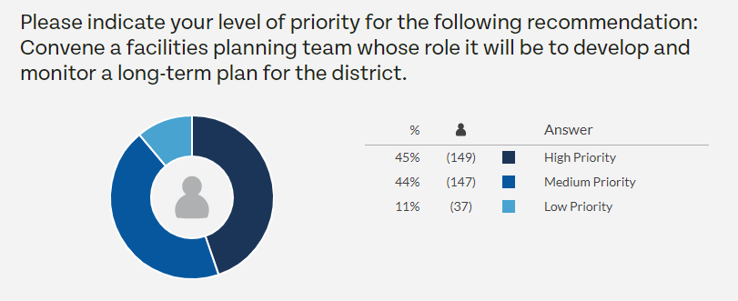
SURVEY RESPONSES: Facilities Planning Team

Slide 35
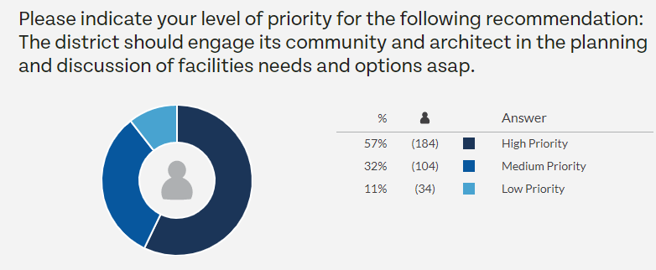
SURVEY RESPONSES: Engage Community and Architect

Slide 36
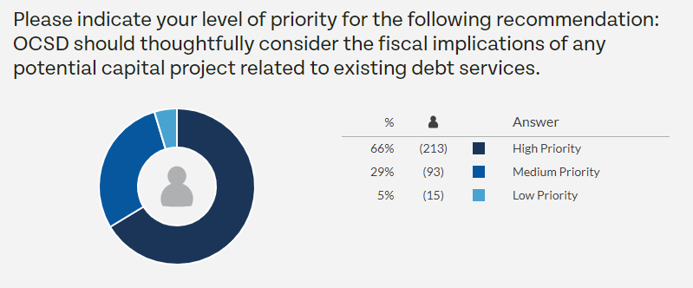
SURVEY RESPONSES: Careful Consideration of Capital Projects

Slide 37

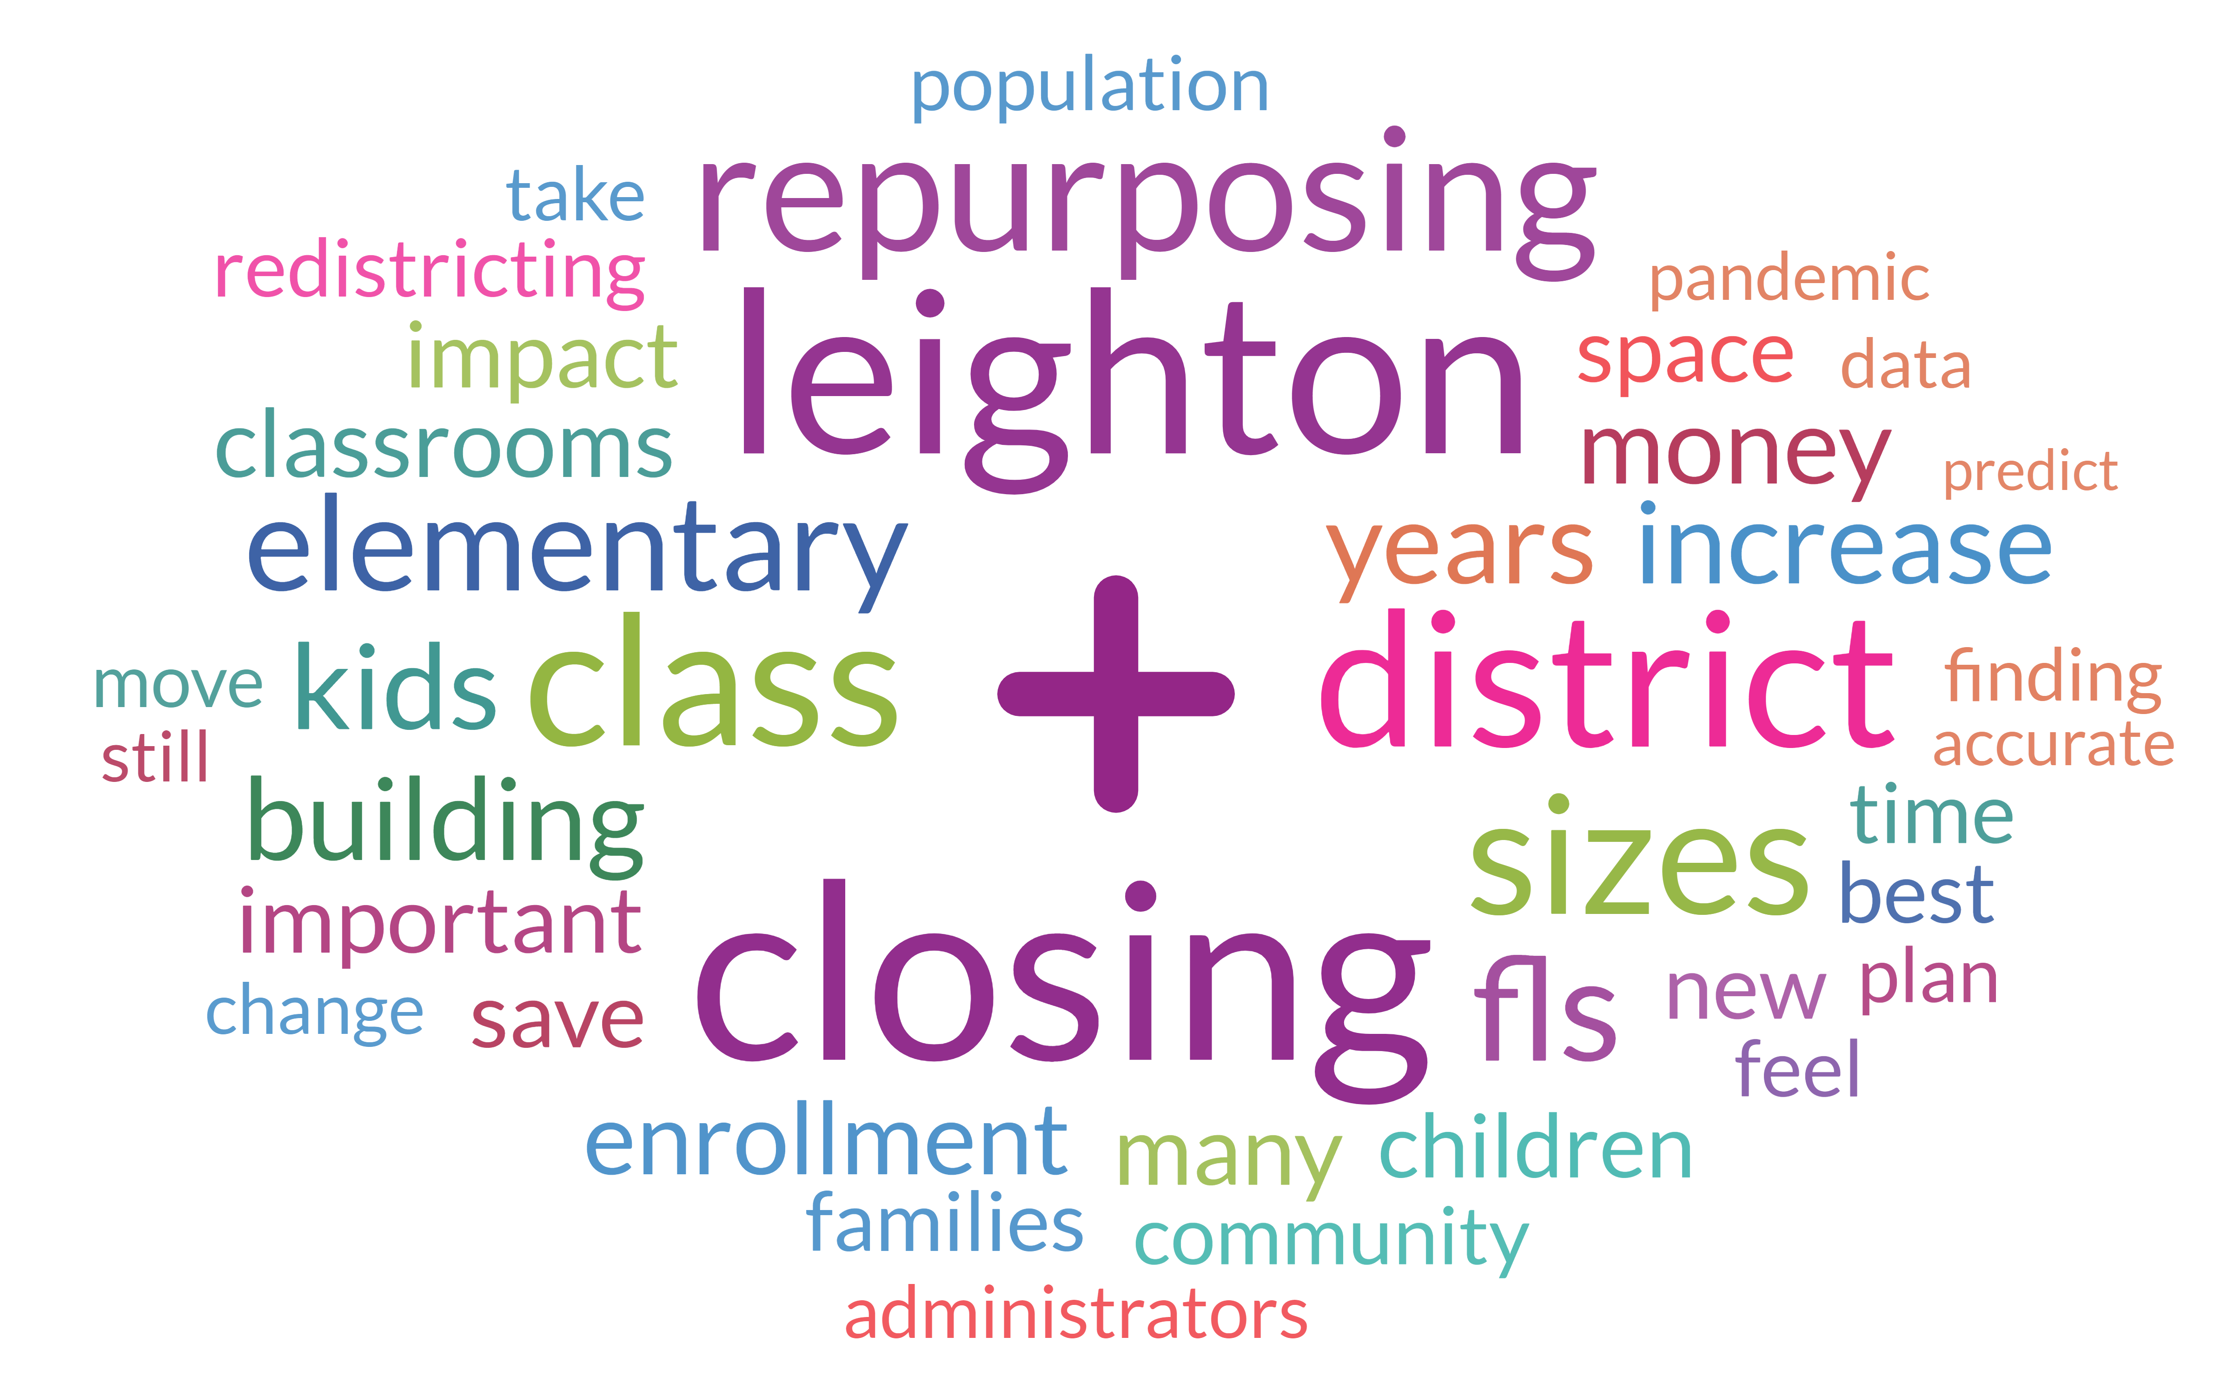
WORDCLOUD: Most Frequent Terms

Slide 38


THOUGHTS: Key Thoughts

Slide 39

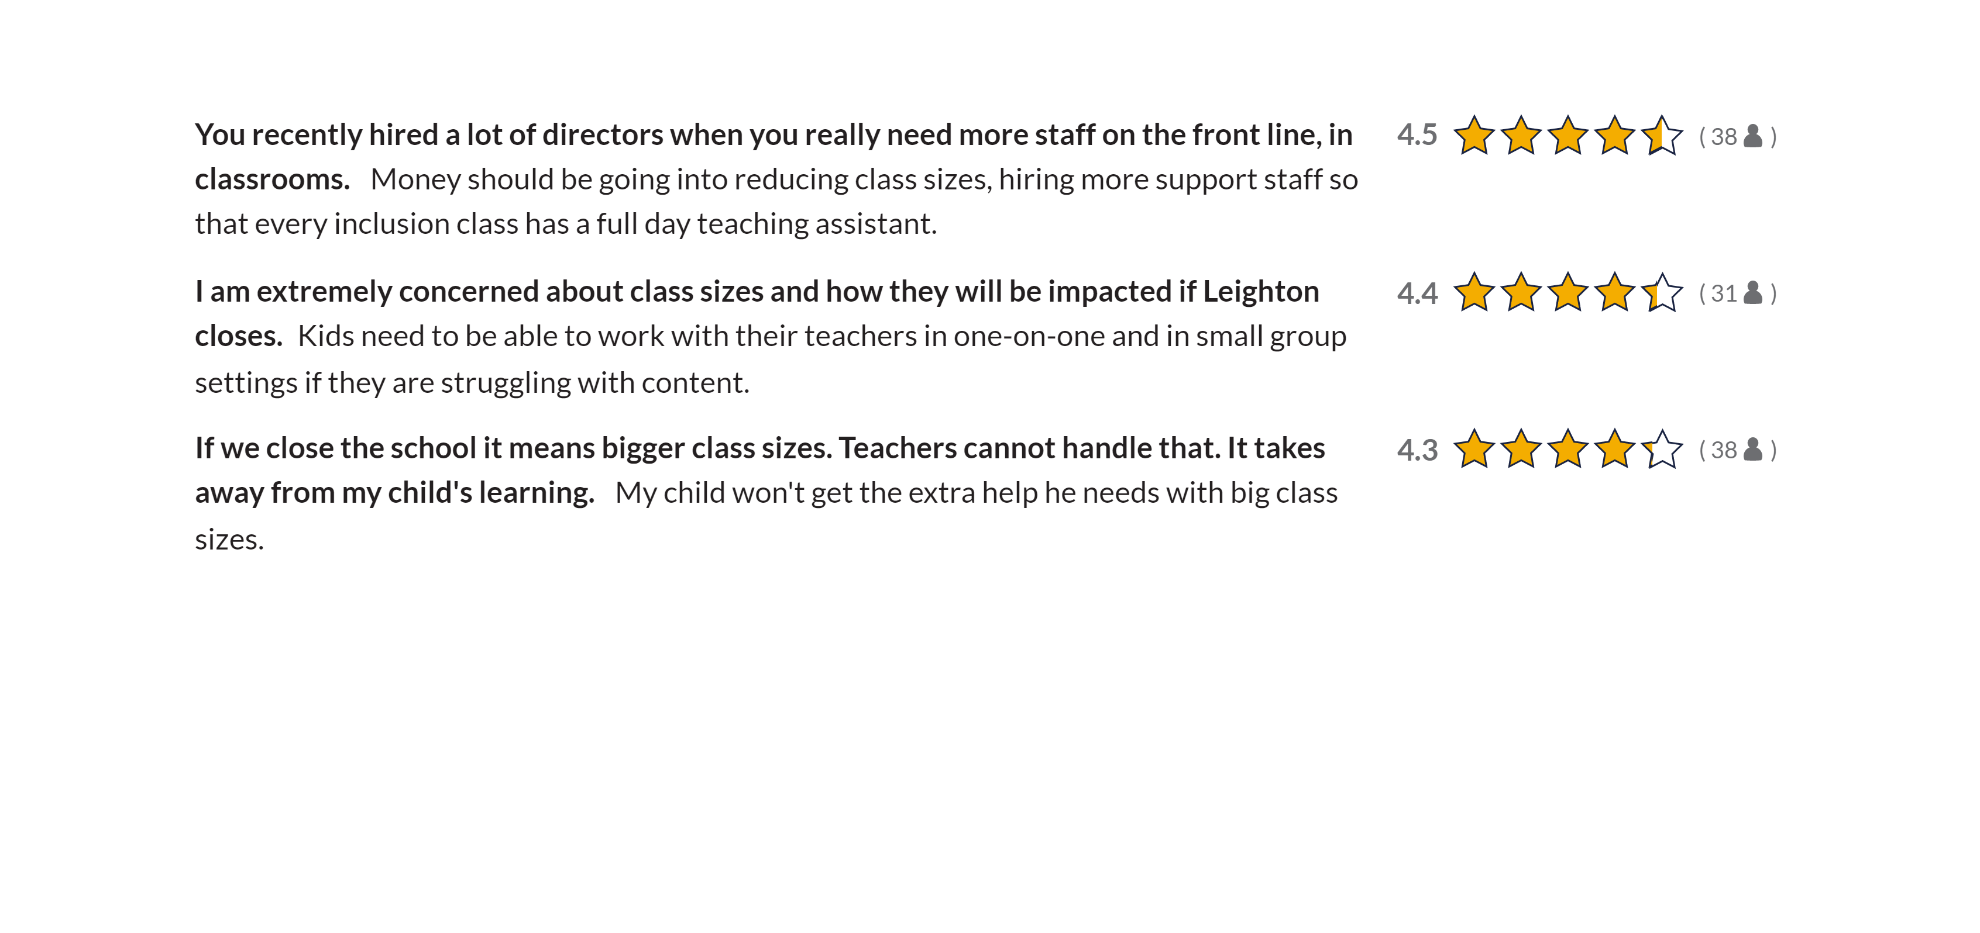
THOUGHTS THEME: Class Sizes

Slide 40
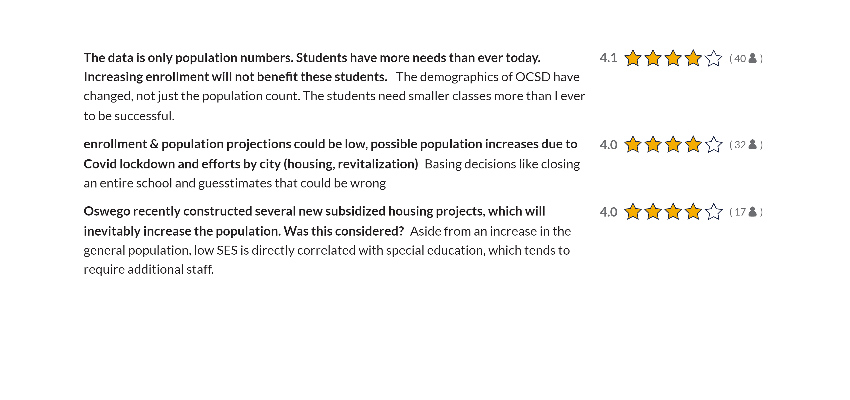
THOUGHTS THEME: Enrollment

Slide 41
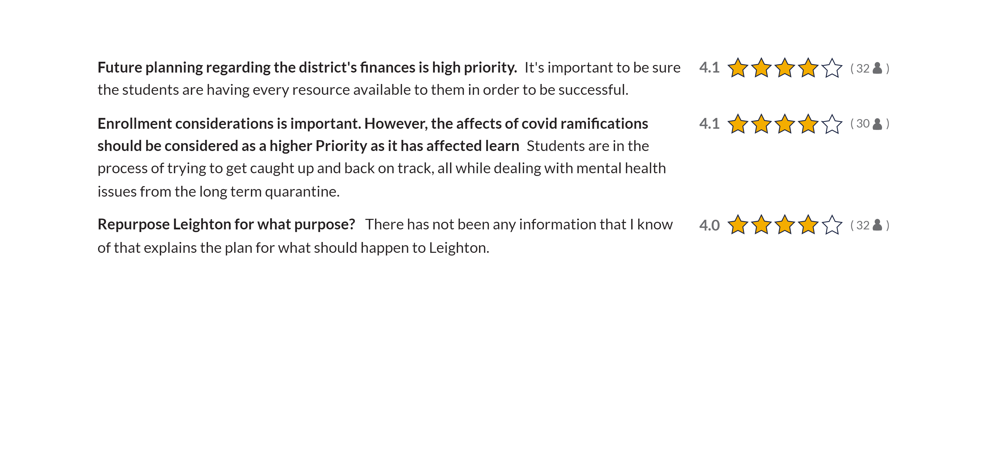
THOUGHTS THEME: Plan

Slide 42
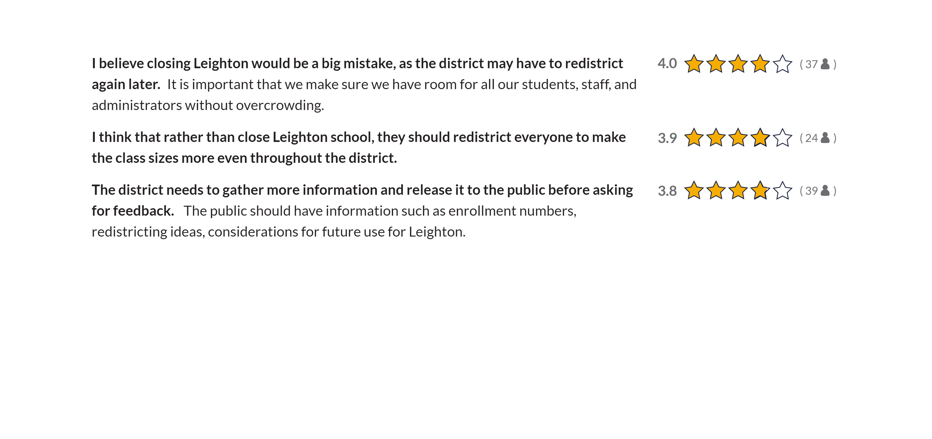
THOUGHTS THEME: Redistricting

Slide 43

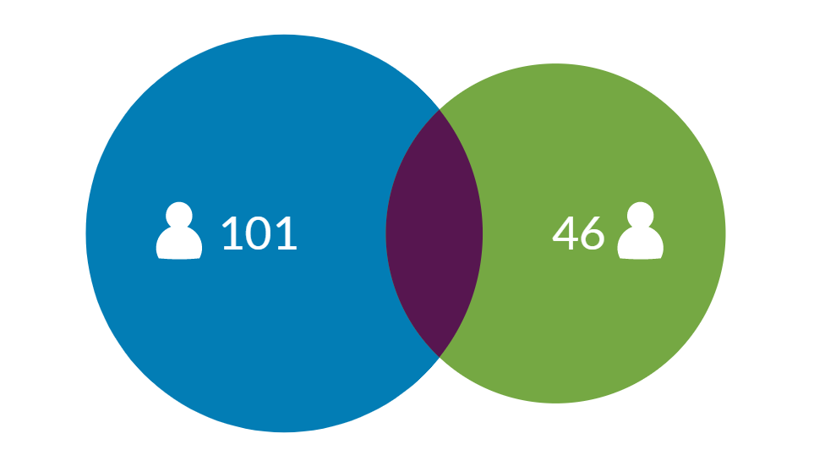
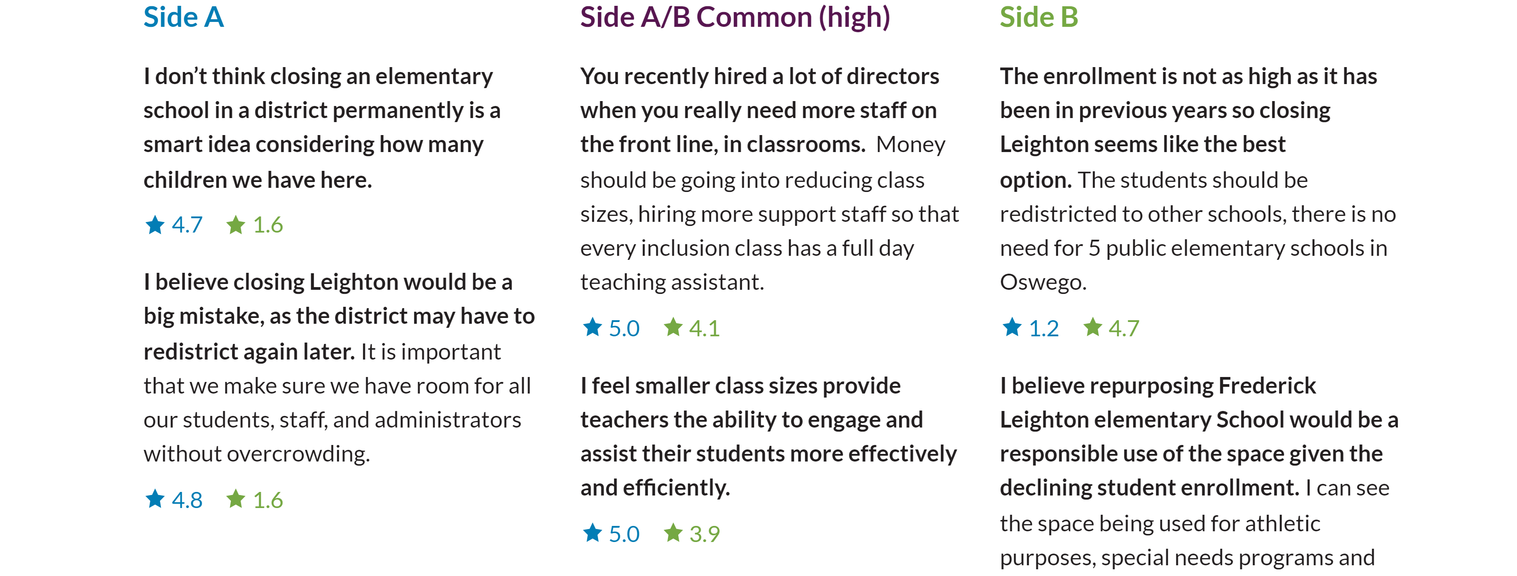
DIFFERENCES: Closing Leighton

Slide 44
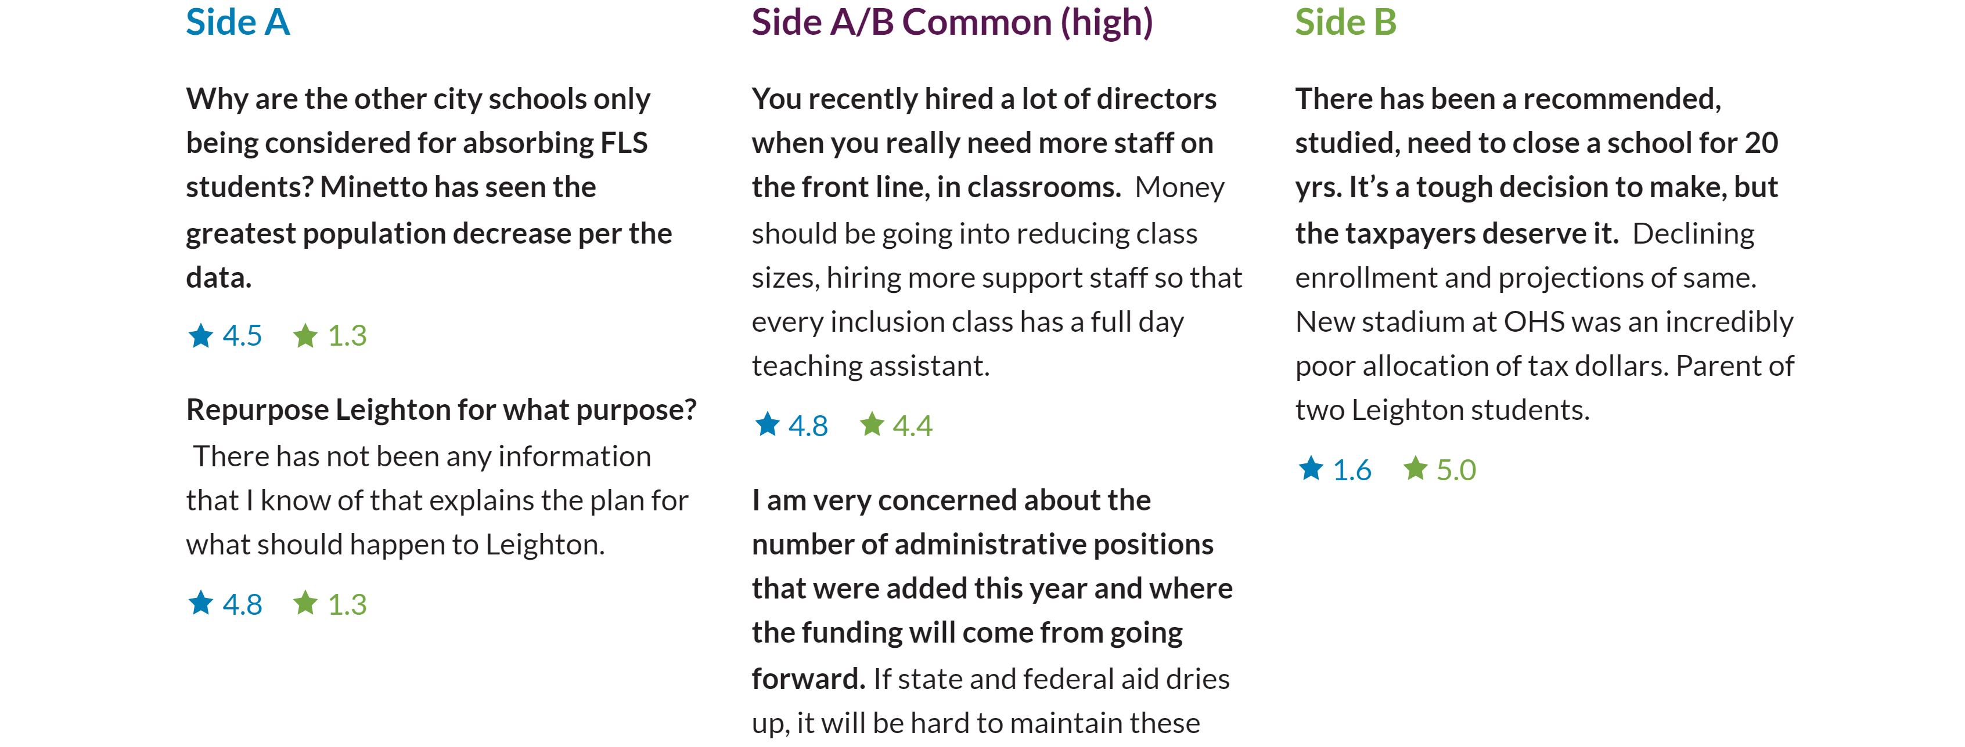

DIFFERENCES: Declining Enrollment

Slide 45
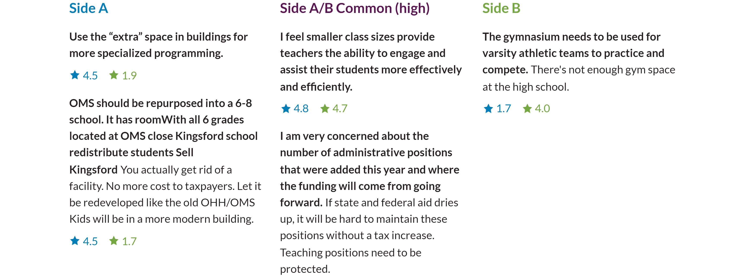
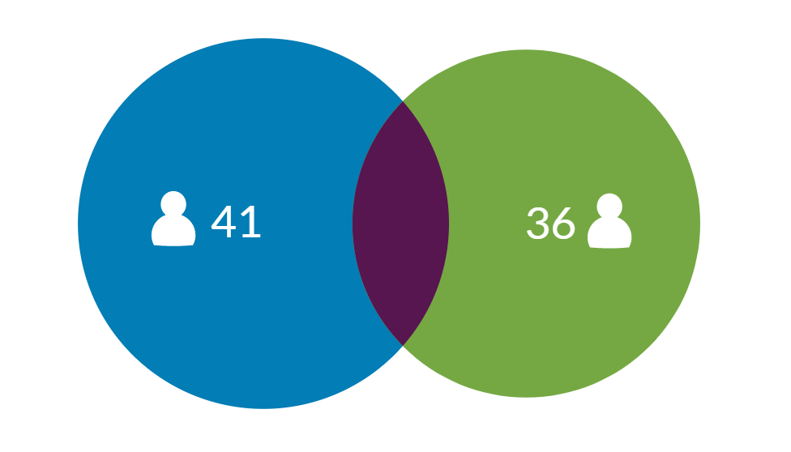
DIFFERENCES: Space

Slide 46


Slide 47
Study Information
Tonight:
  Labor relations information
  Real-estate information
  Current enrollment and average class sizes
  ThoughtExchange
Future meeting(s):
  Class size information
  Redistricting plan
  Community Focus Group outcomes
  Building Condition Survey information

Slide 48
Funding of Reserves
The preliminary external audit results from this year are showing an approximate surplus of $4,500,000
The Surplus is due to two factors:
  Increase of State Aid (Foundation Aid)
  Federal ARP and ESSER Funding has supported General Fund Expenditures thereby causing the budget to be underspent
This amount is not unusual in the current environment due to ARP and ESSER funding and additional state aid
We will need to retroactively fund reserves or the district will be over the 4% limit.
The district has recommended a flexible reserve funding option
Please keep in mind the new reserve opportunities that the Board might want to create that require voter approval, per the Timbs study
Tonight’s recommendation provides a temporary “holding” and flexibility until we can fund the new reserves that the Board might be interested in

Slide 49
Reserve | 6/30/22 | Retroactive funding | 6/30/22 | Rationale
Workers Compensation | 655,401 | 1,000,000 | 1,655,401 | We are self funded for Workers Compensation. This is a flexible reserve
Unemployment | 3,251,665 | 1,000,000 | 4,251,665 | Flexible reserve
ERS | 2,526,774 | 559,118 | 3,085,892 | Rates are projected to increase
TRS | 1,170,120 | 640,882 | 1,811,002 | This is funded up to 2% of the previous teachers' wages. Rates are projected to increase.
Liability | 1,970,838 | 0 | 1,970,838 | This can be used for pending lawsuits or substitutes for people on leave pending investigation
Tax Certiorari | 1,034,491 | 0 | 1,034,491
Capital | 5,075,042 | 1,600,000 | 6,675,042 | This could help with future capital projects to offset the local share and fund a piece of any future project
Employee Benefits | 2,575,423 | 0 | 2,575,423 | To fund contractual benefit payouts for employees at retirement
Total | 18,259,754 | 4,800,000 | 23,059,754

Slide 50


