Slide 1
Exchange Summary
Nancy Squairs, Oswego City School District
May 15, 2023
As we plan for the next school year, how do you think the district should use the increase in Foundation Aid to address student performance and needs?

Slide 2
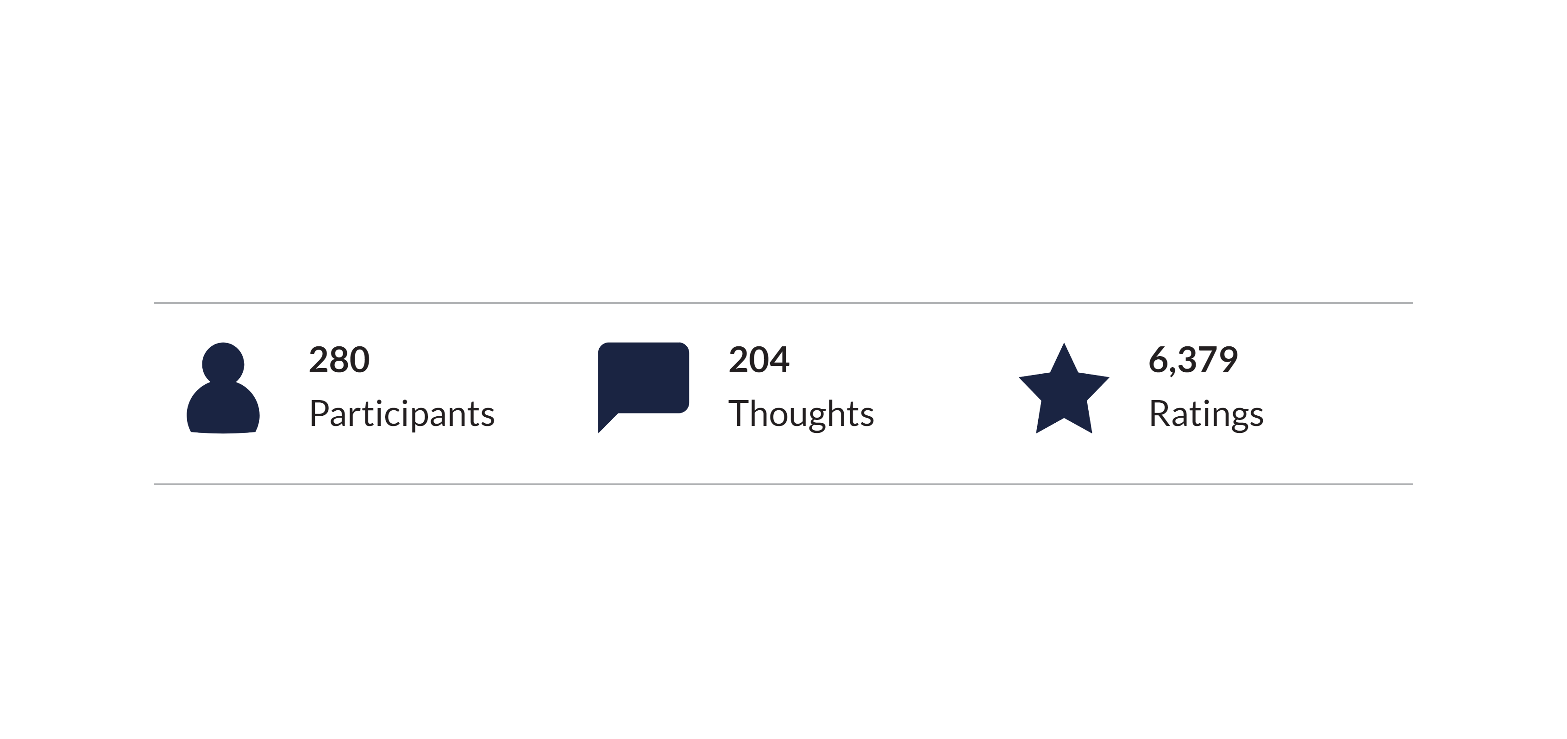
PARTICIPATION
Breakdown of Participation

Slide 3
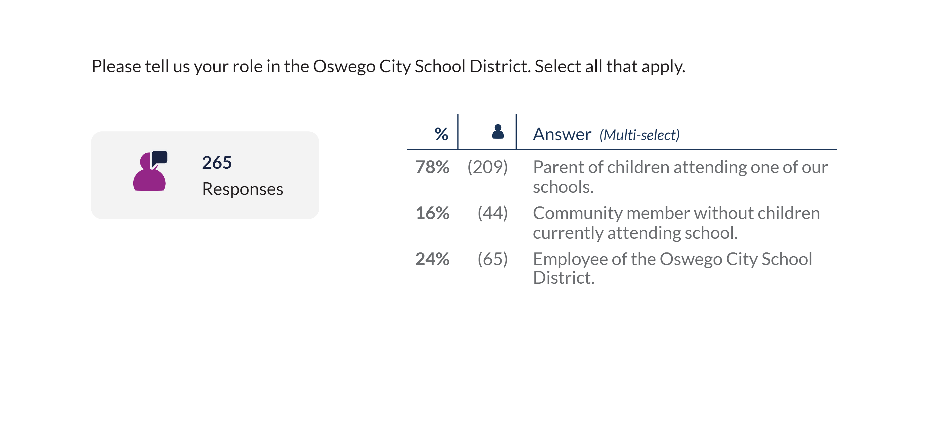
PARTICIPATION
Breakdown of Participation

Slide 4
WORDCLOUD
Top Rated

Slide 5
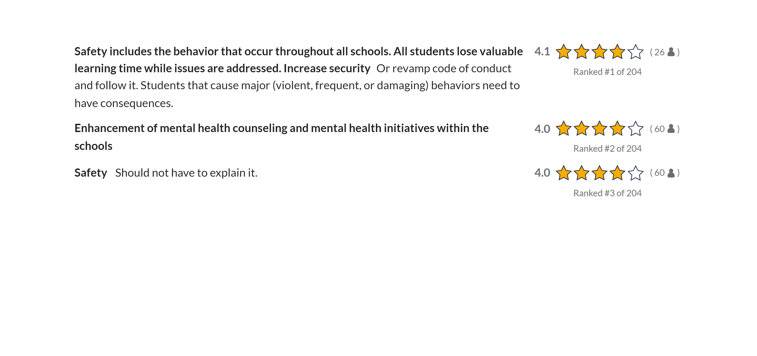
THOUGHTS
Key Thoughts

Slide 6
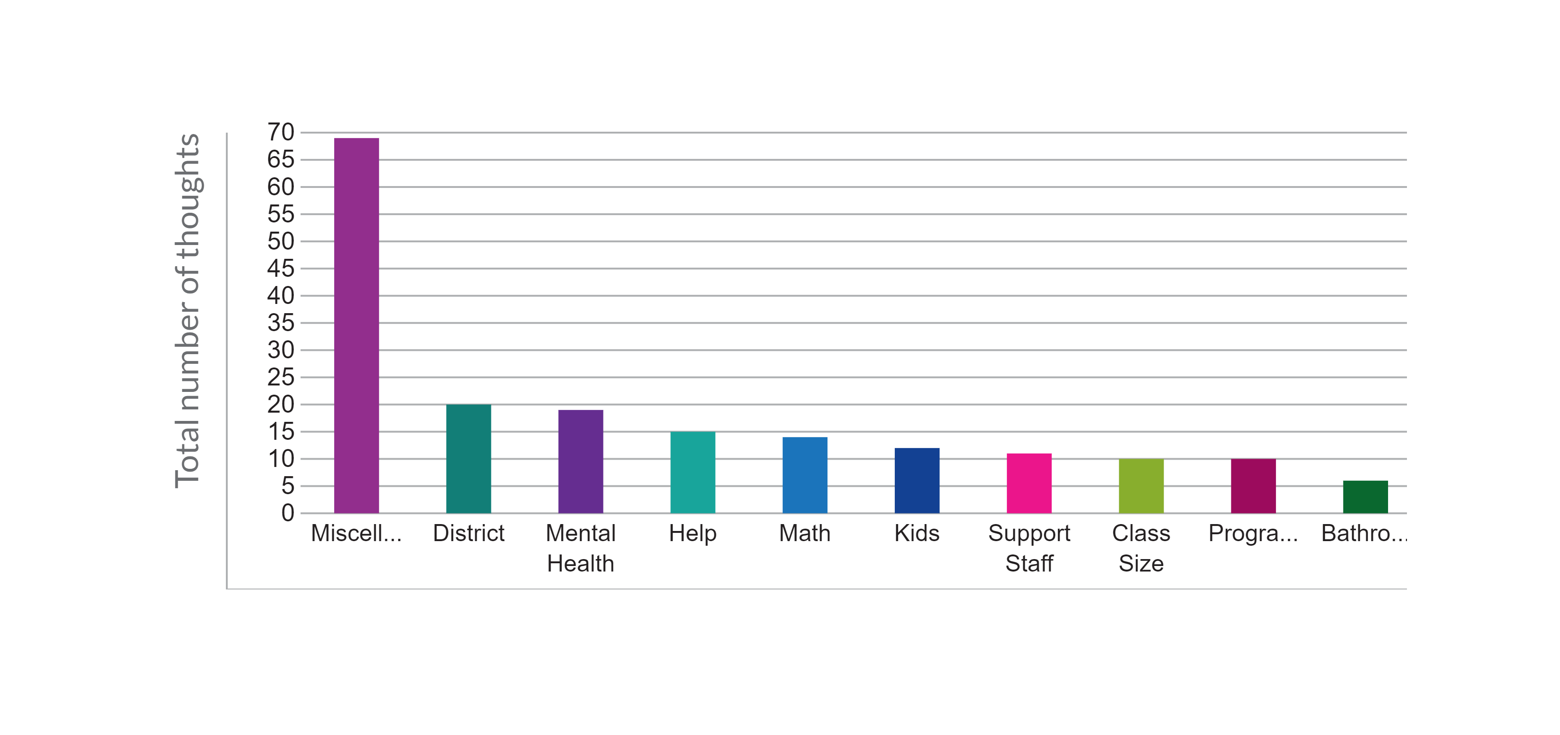
KEYWORD THEMES
Top Themes by total thoughts

Slide 7
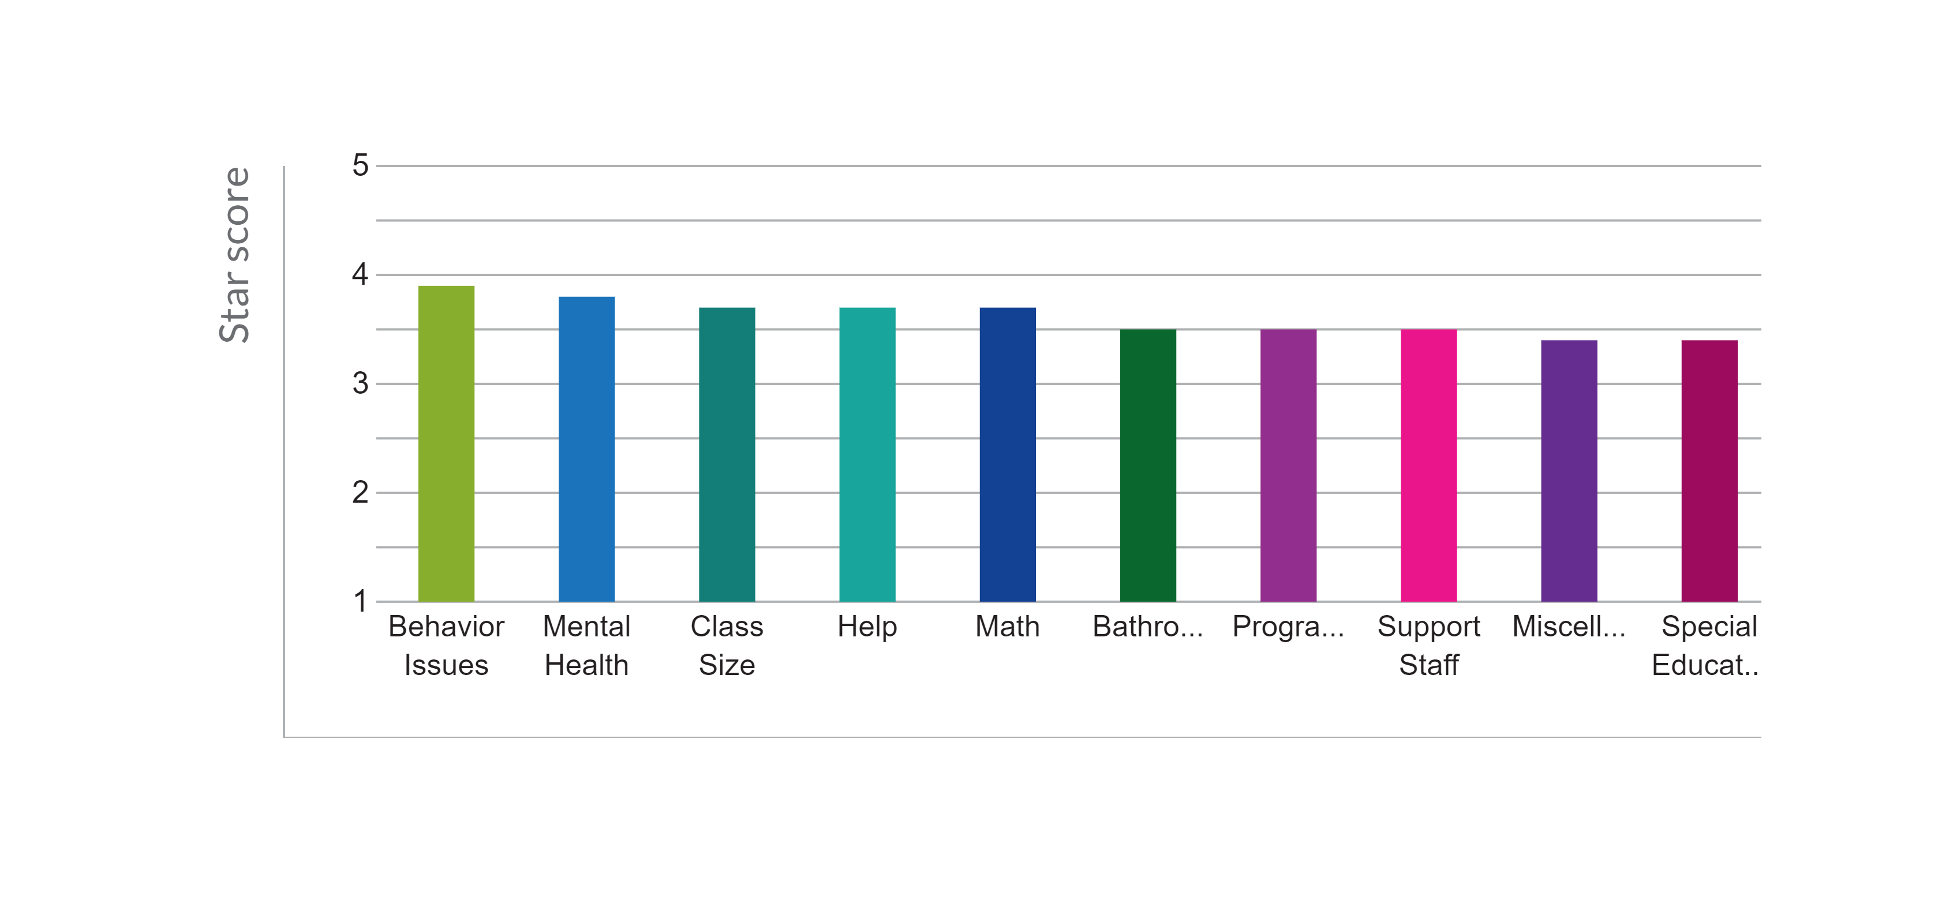
KEYWORD THEMES
Top Themes by star score

Slide 8
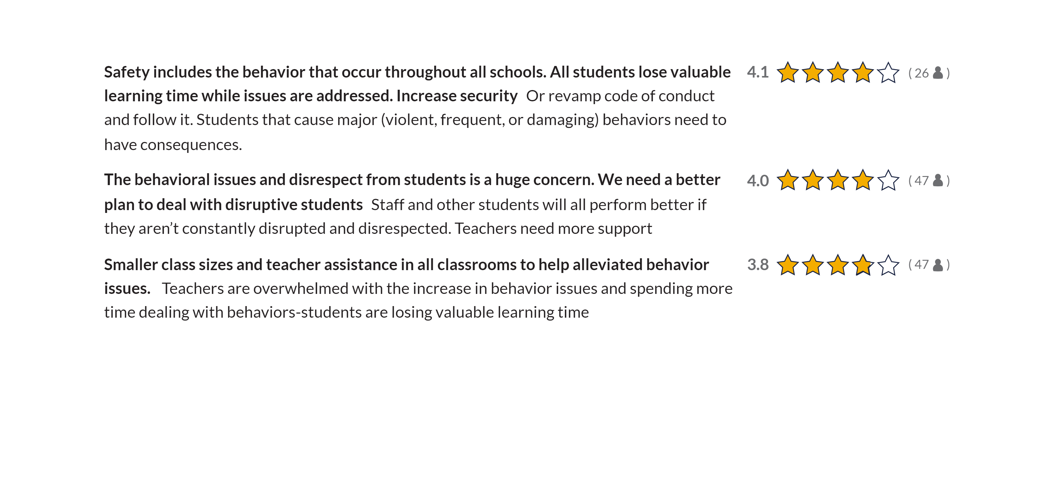
THOUGHTS
Behavior Issues

Slide 9
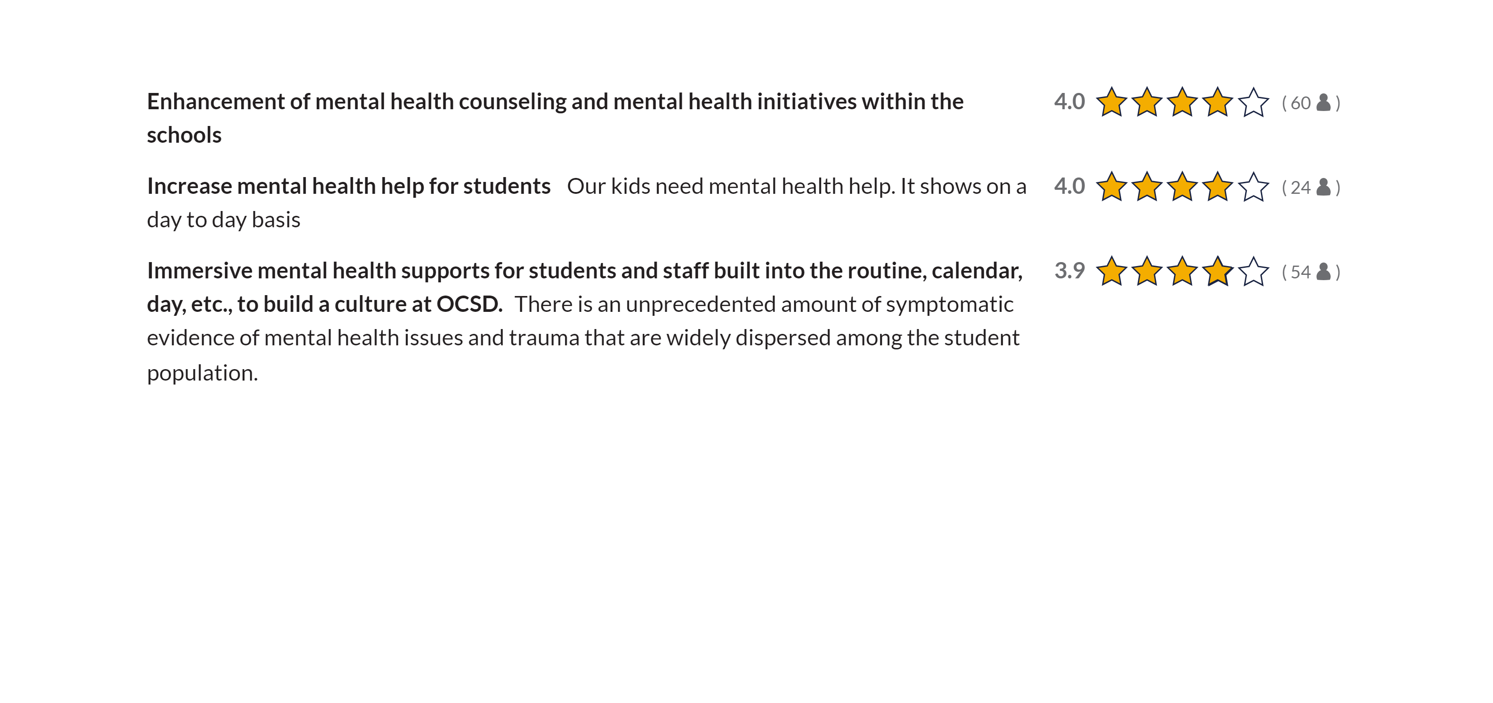
THOUGHTS
Mental Health

Slide 10
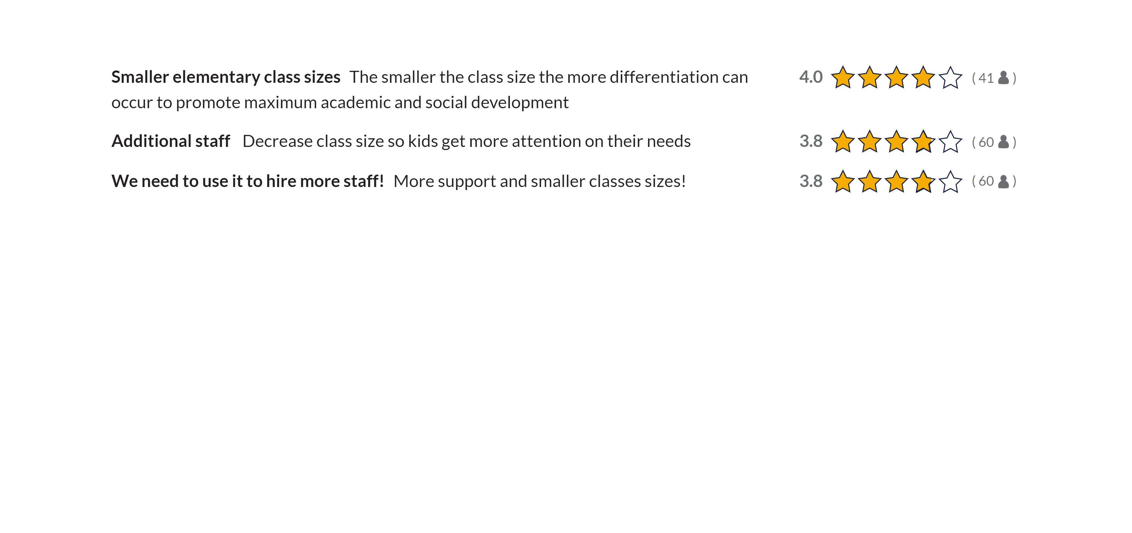
THOUGHTS
Class Size

Slide 11
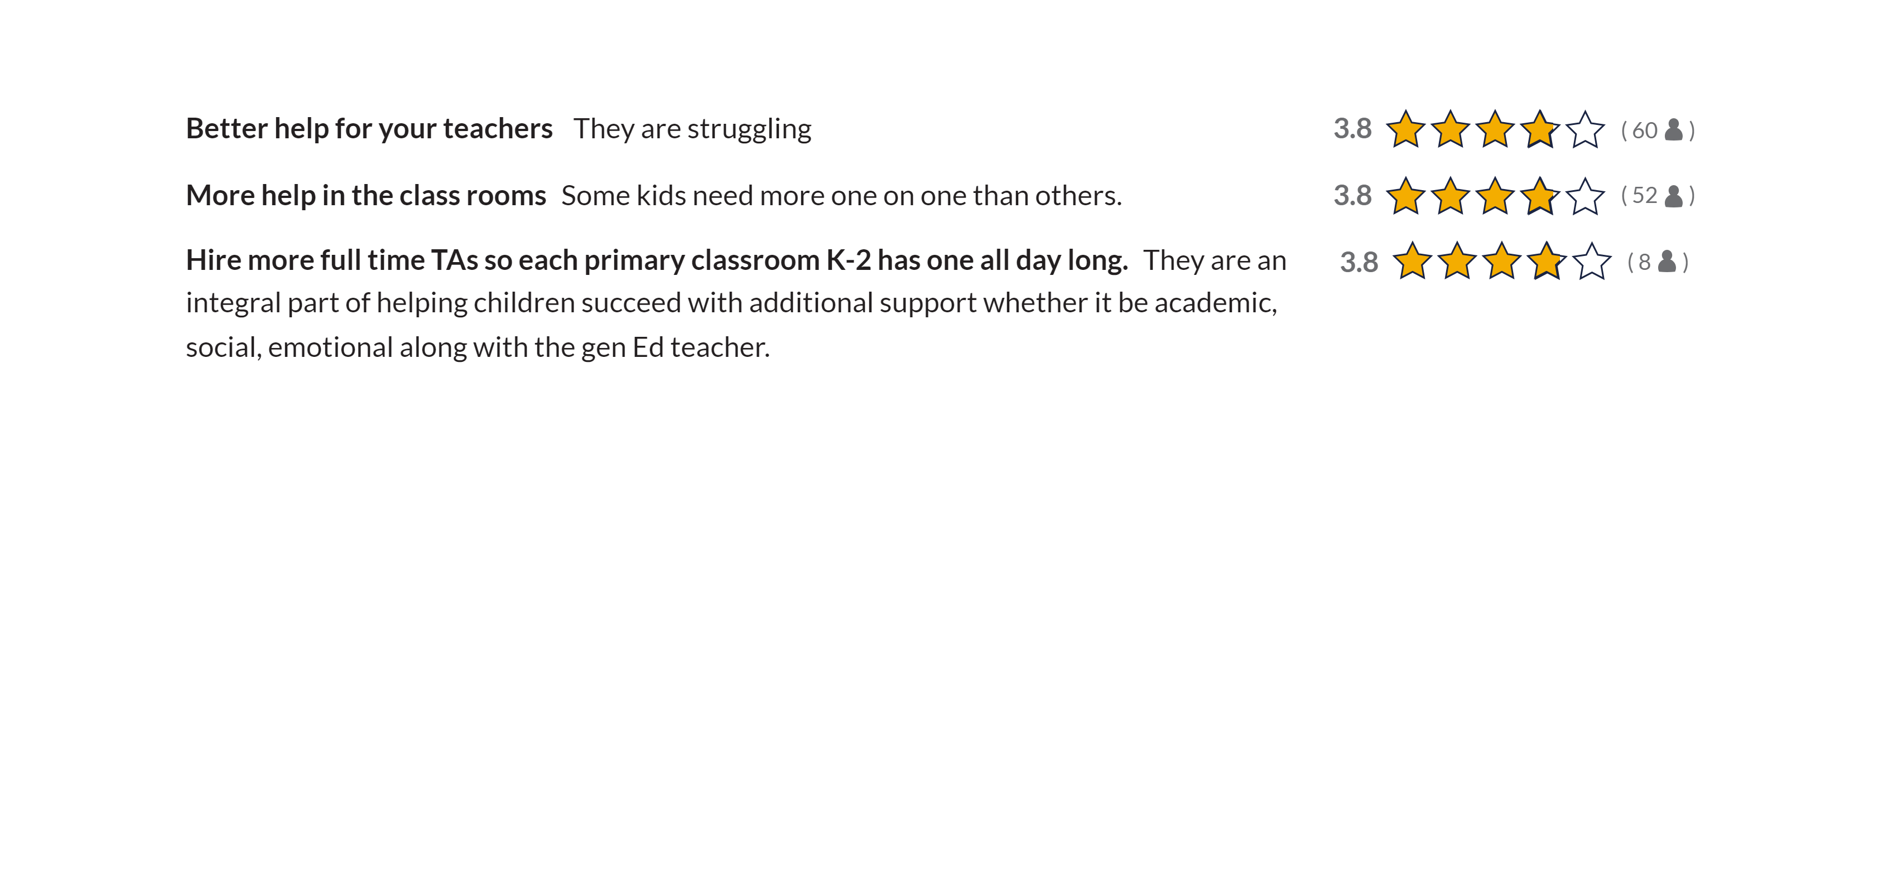
THOUGHTS
Help

Slide 12
THOUGHTS
Math

Slide 13
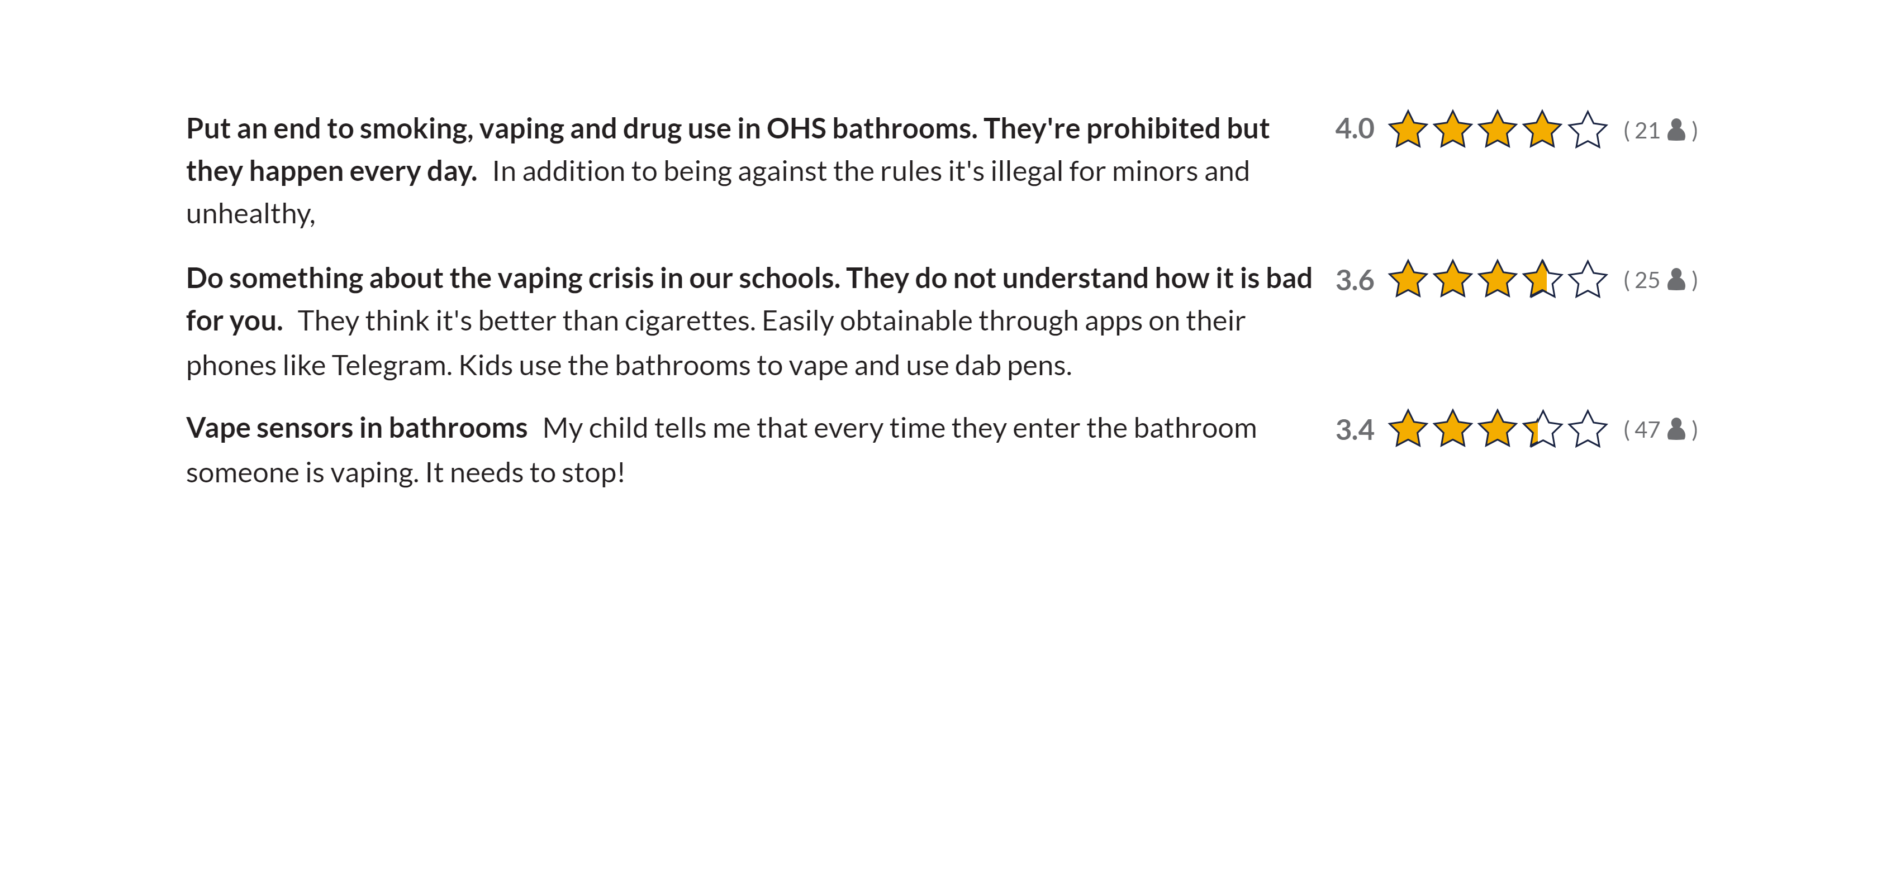
THOUGHTS
Bathrooms

Slide 14
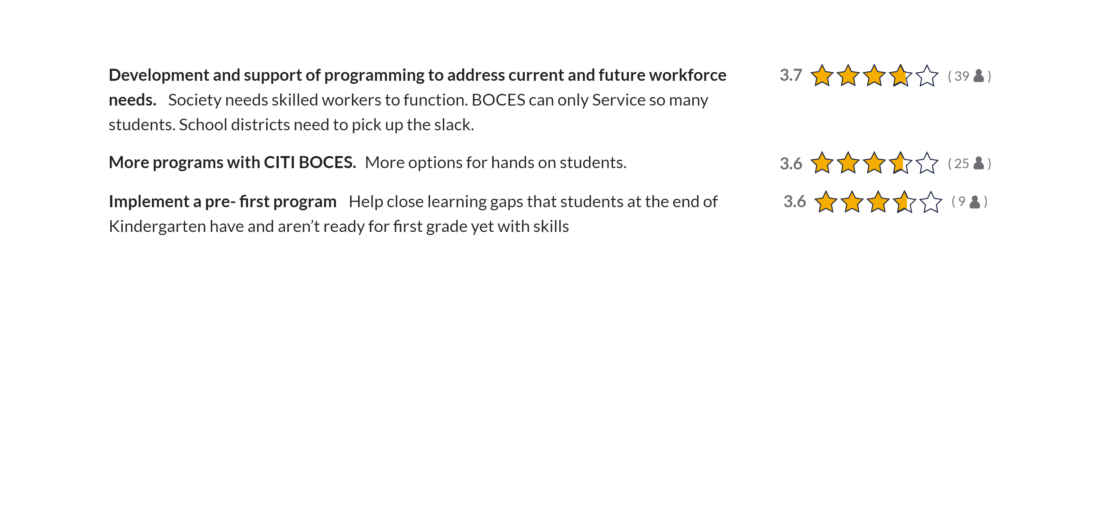
THOUGHTS
Programs

Slide 15
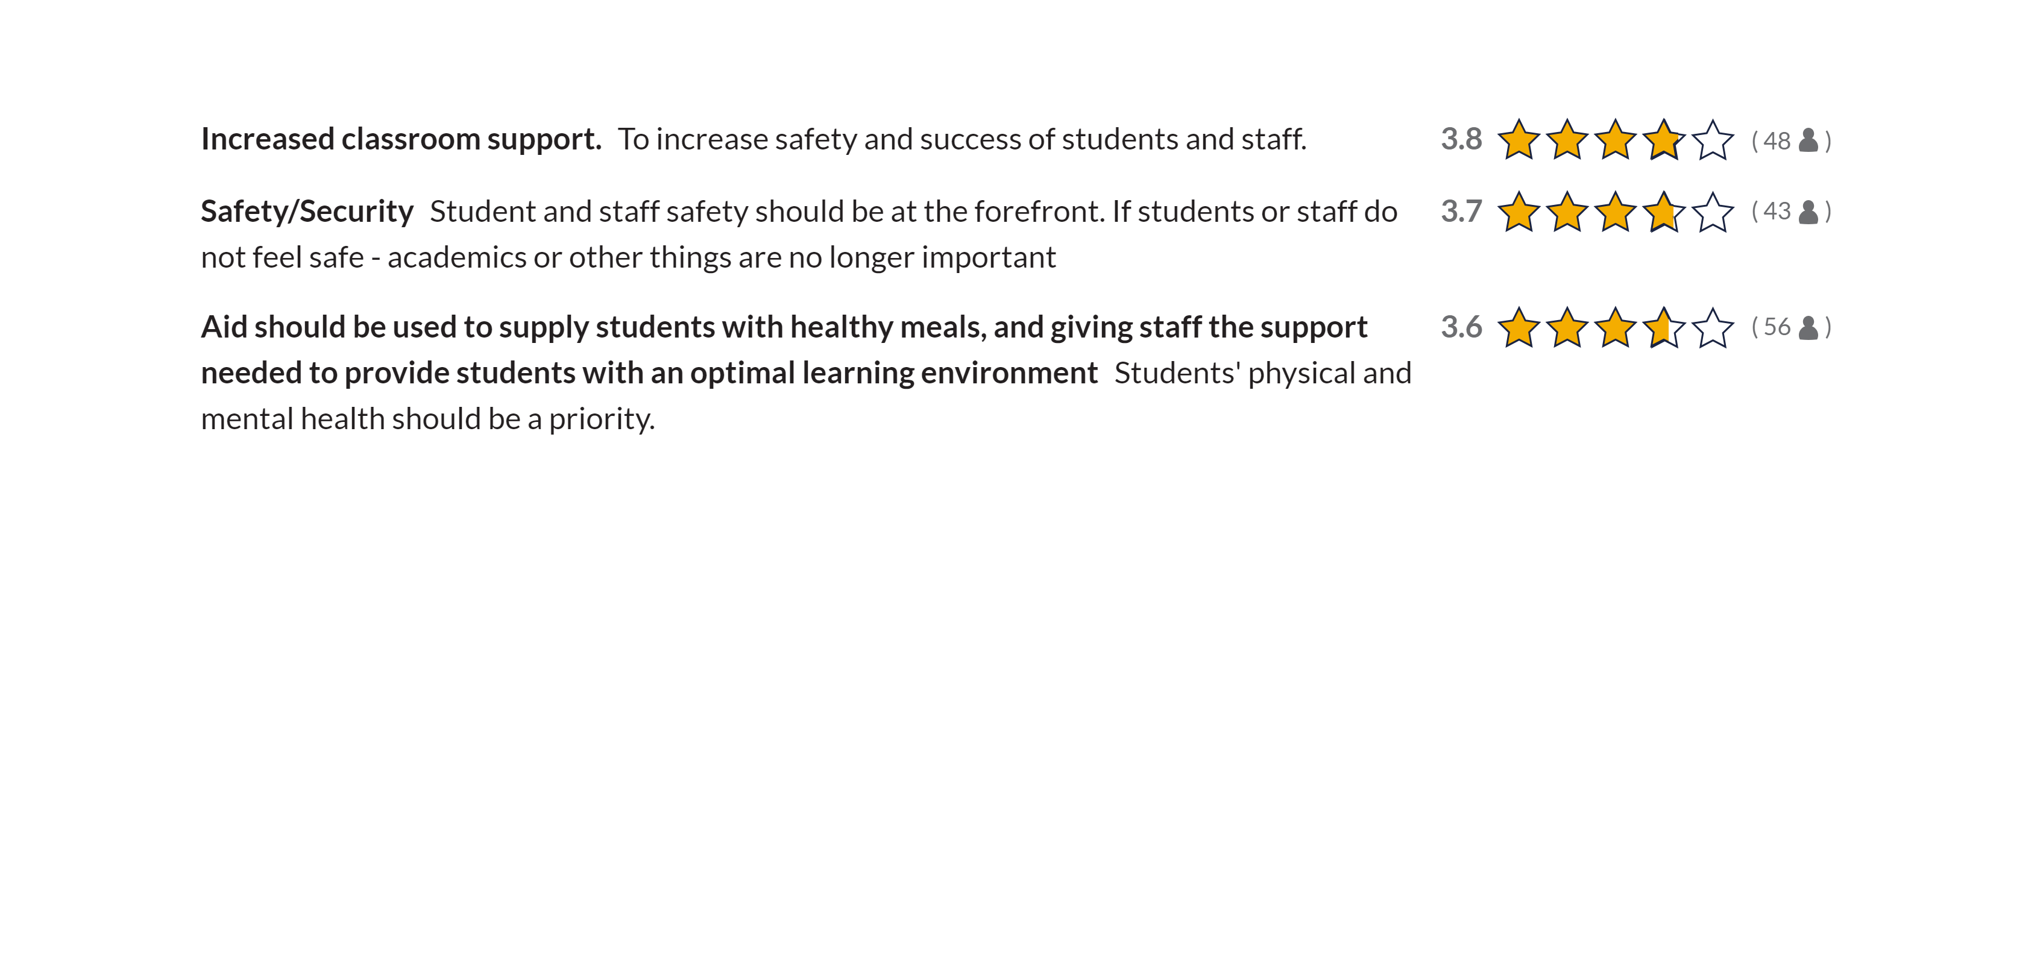
THOUGHTS
Support Staff

Slide 16
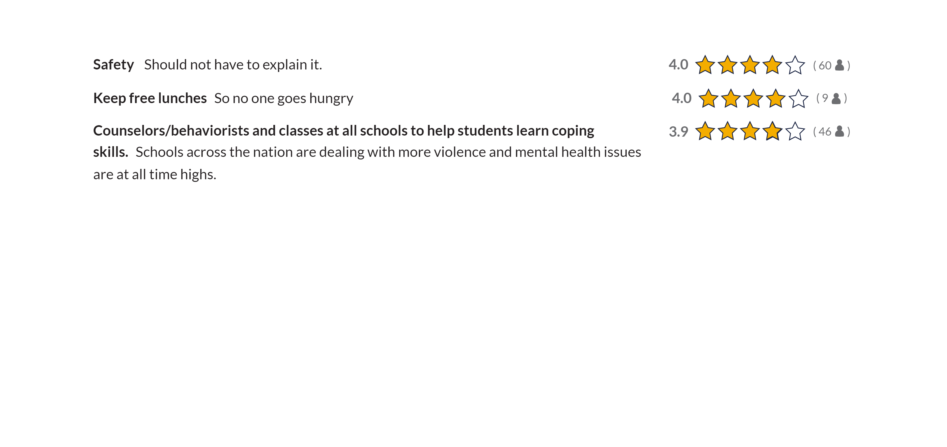
THOUGHTS
Miscellaneous

Slide 17
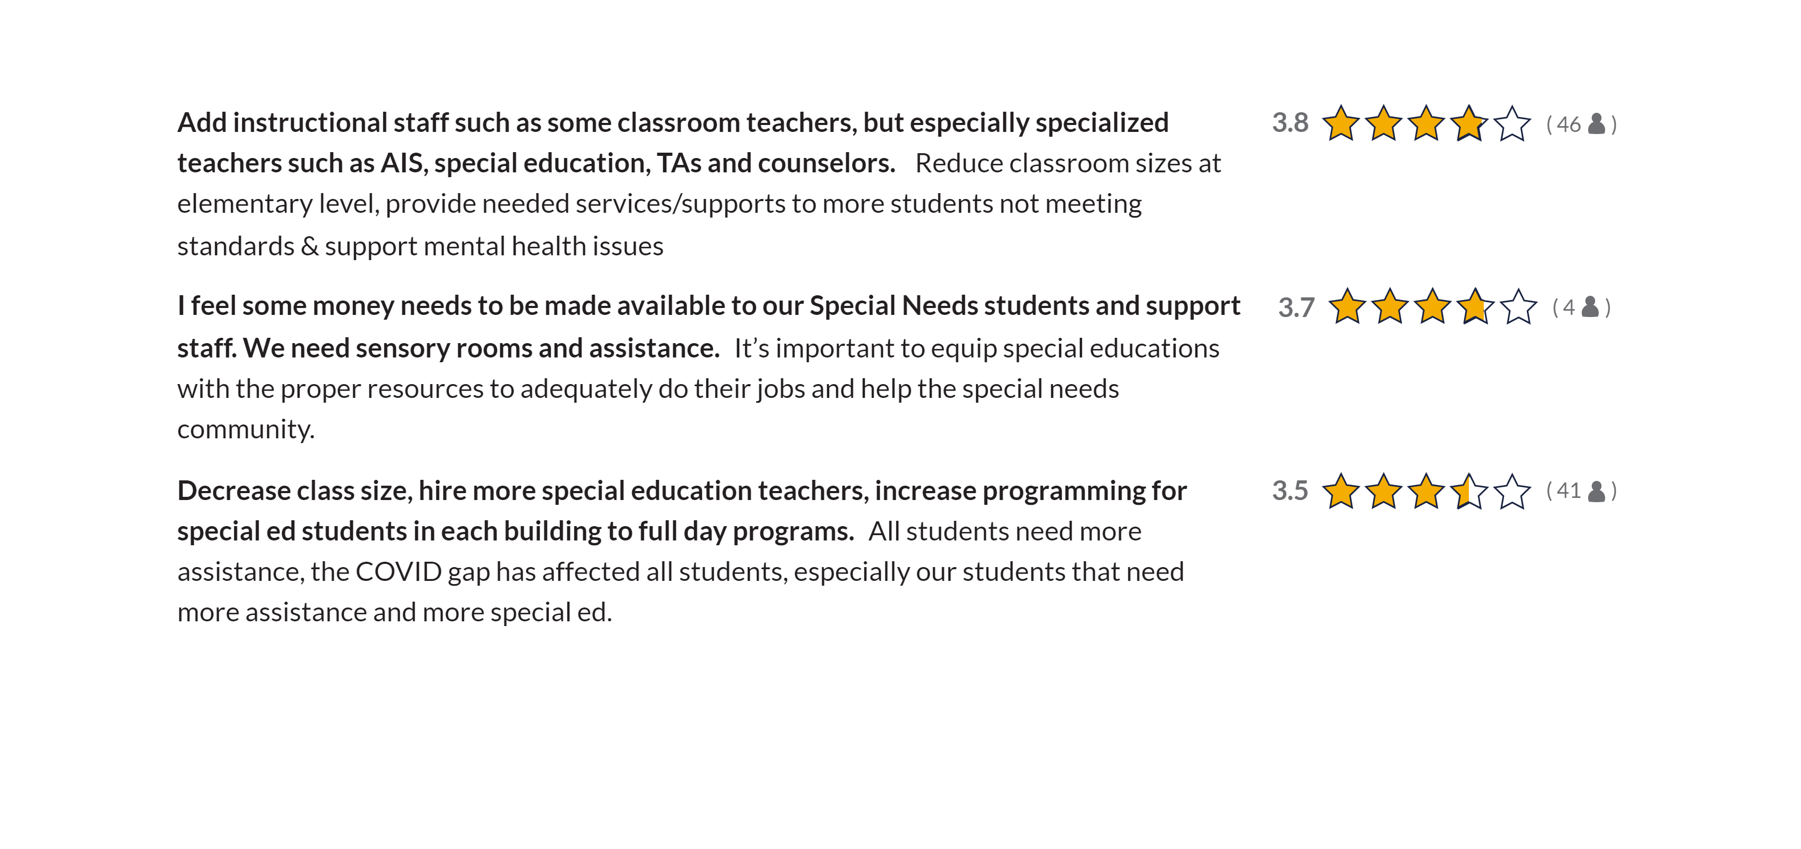
THOUGHTS
Special Education

Slide 18
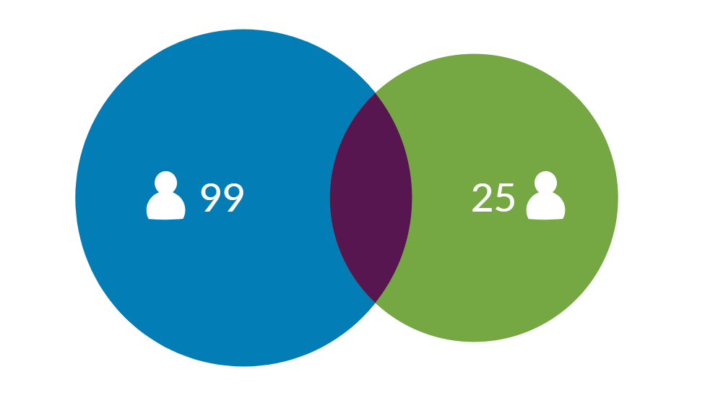
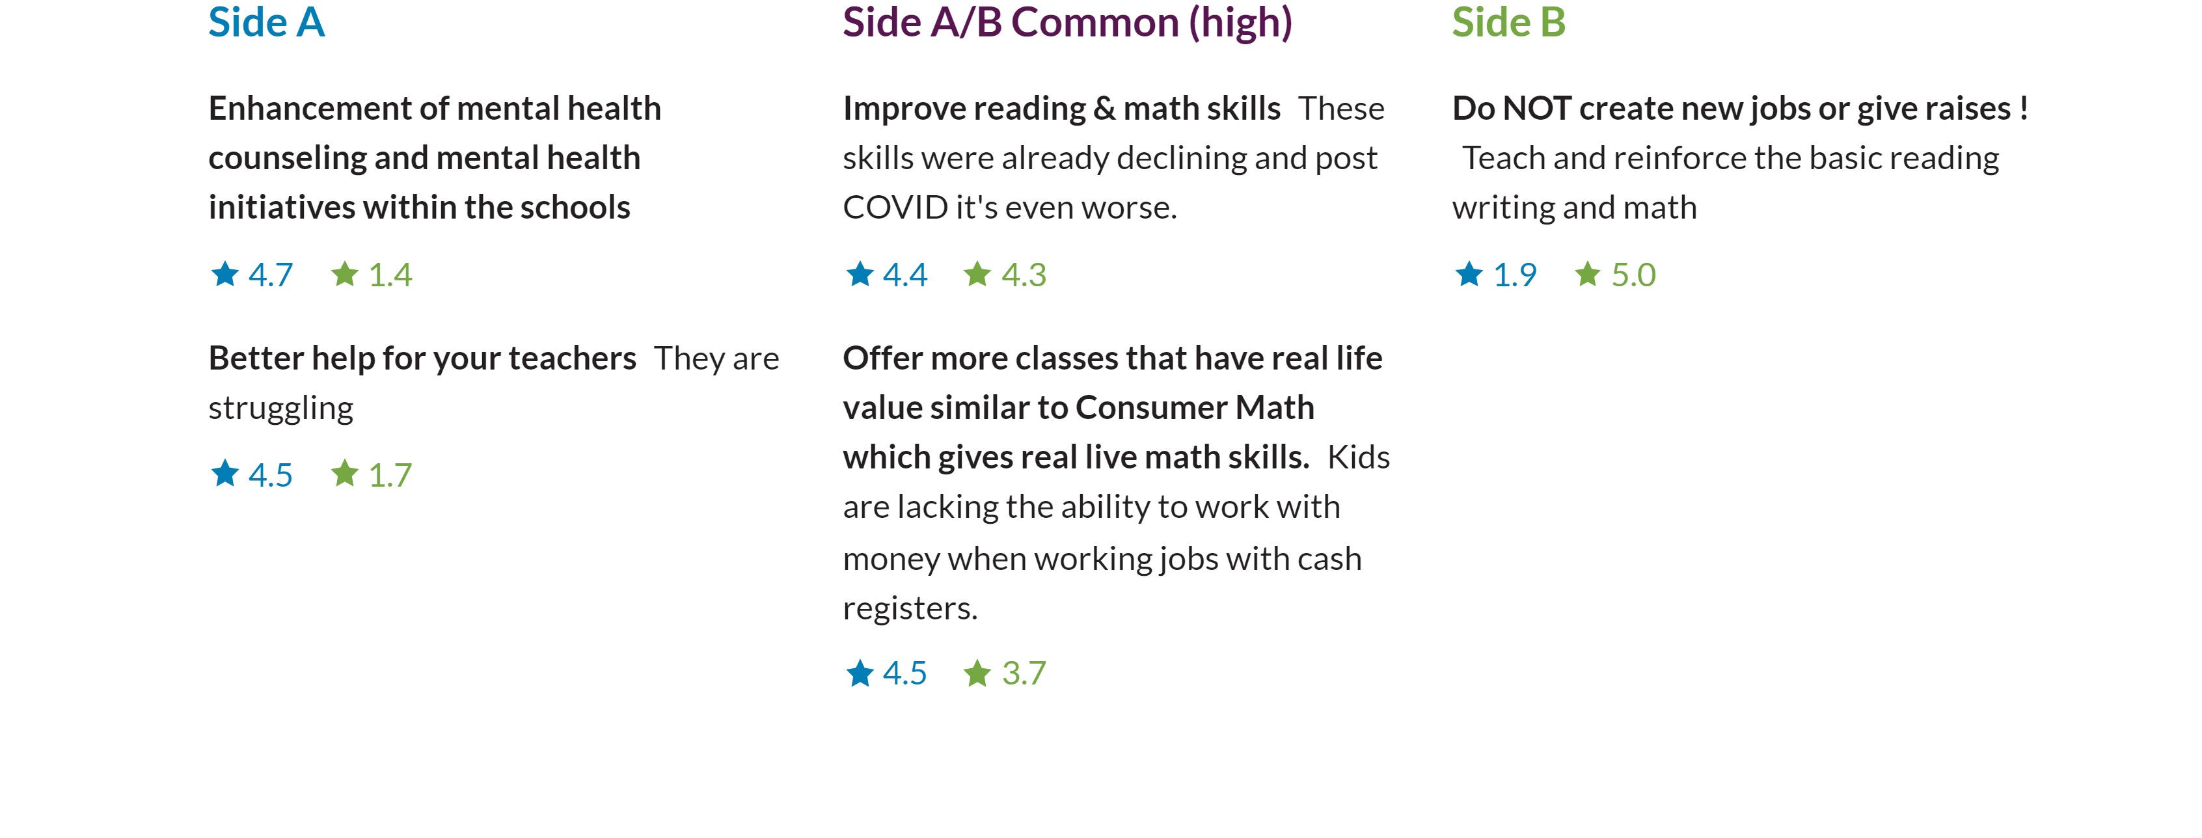
DIFFERENCES
Mental Health | Math and Reading [99 | 25]

Slide 19
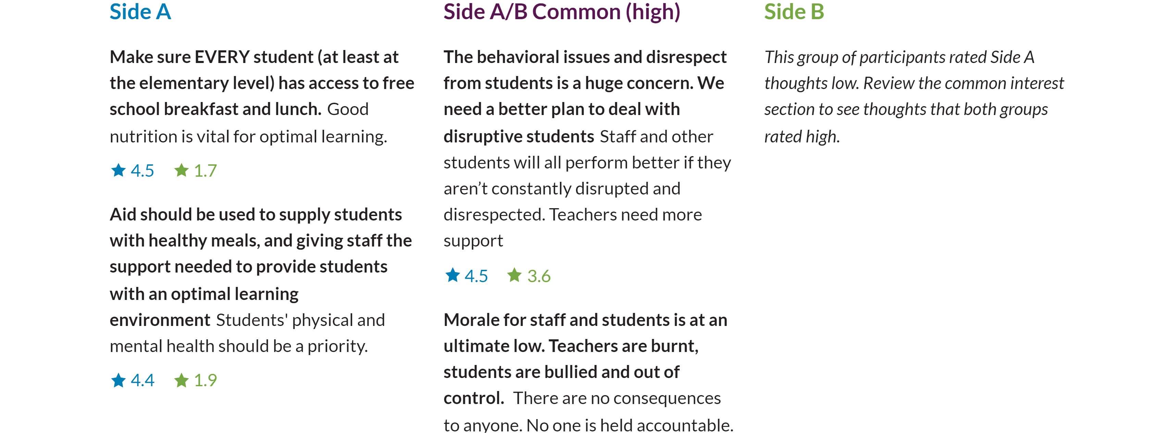
DIFFERENCES
Help Support [73 | 41]

Slide 20
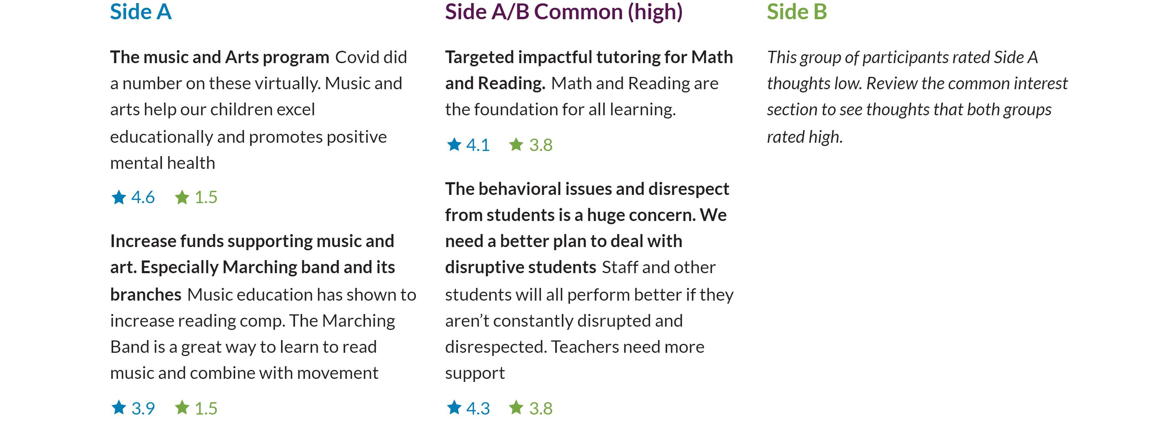
DIFFERENCES
Playground, Education and Activities [58 | 38]

Slide 21
WRAP UP
Next Steps
Thanks for participating
We'll be carefully considering what we learned and sharing our actions back with you.

